Slide 1


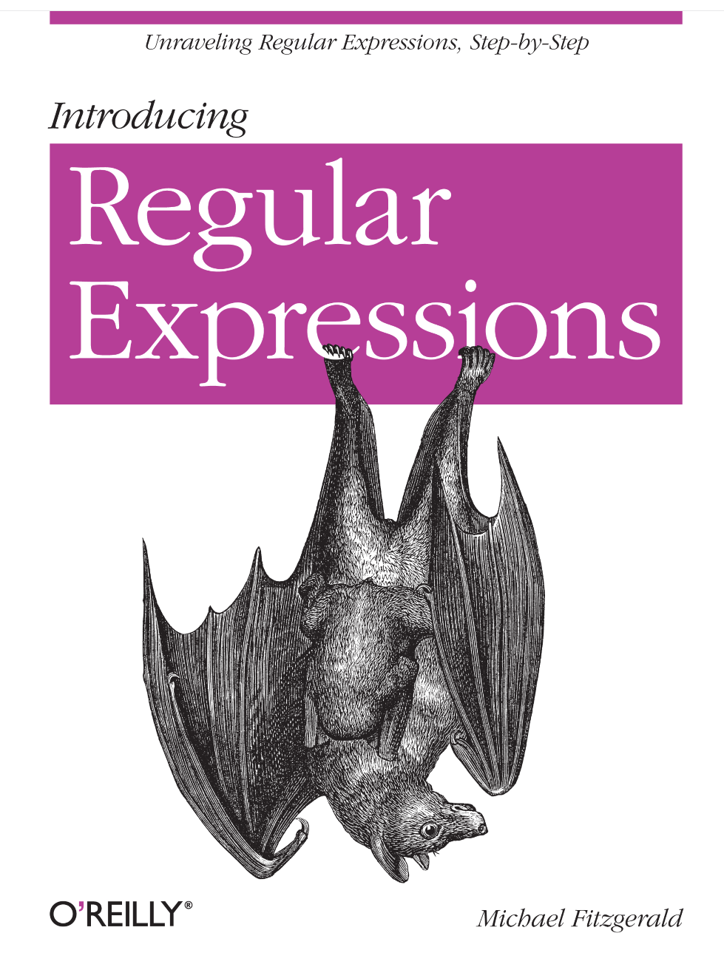
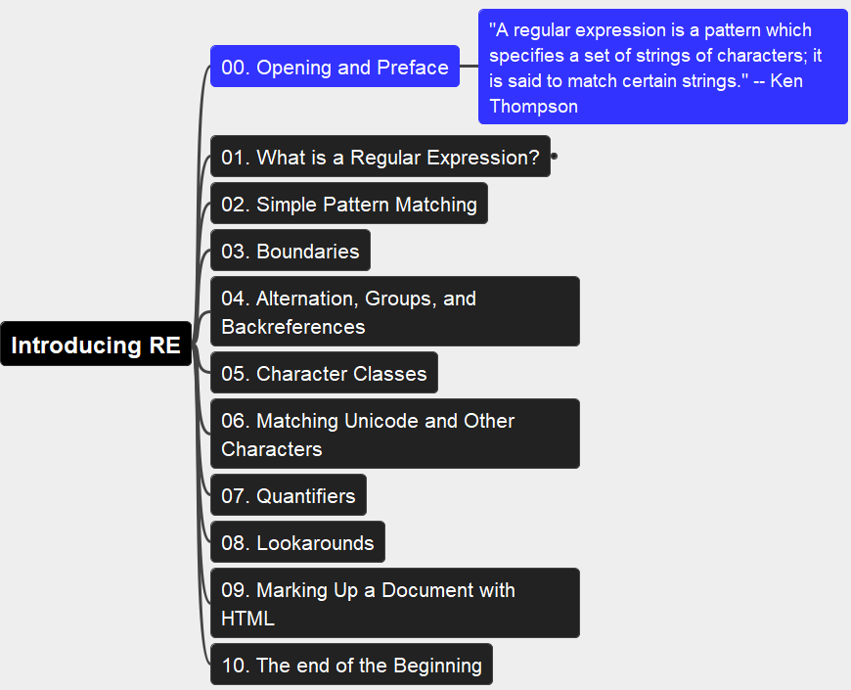
Introducing Regular Expressions
001
Opening and Preface
Thanks for Author: Michael Fitzgerald

Slide 2
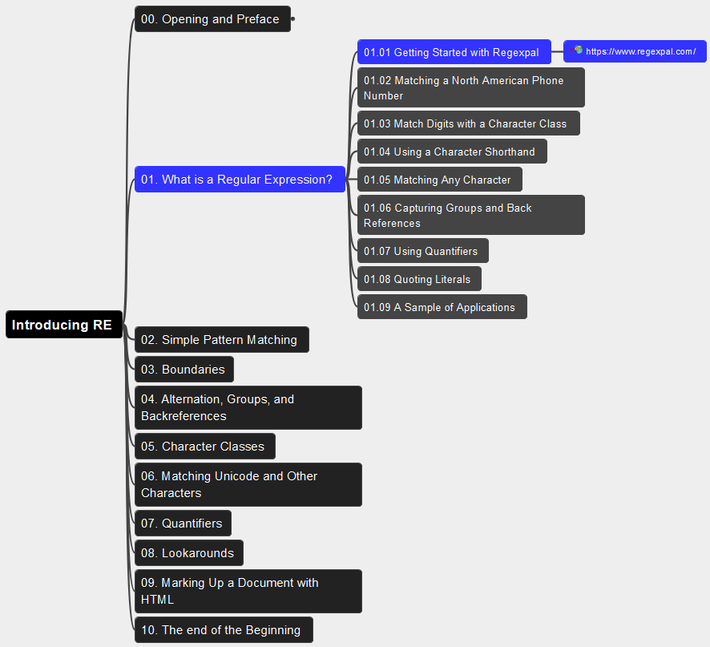
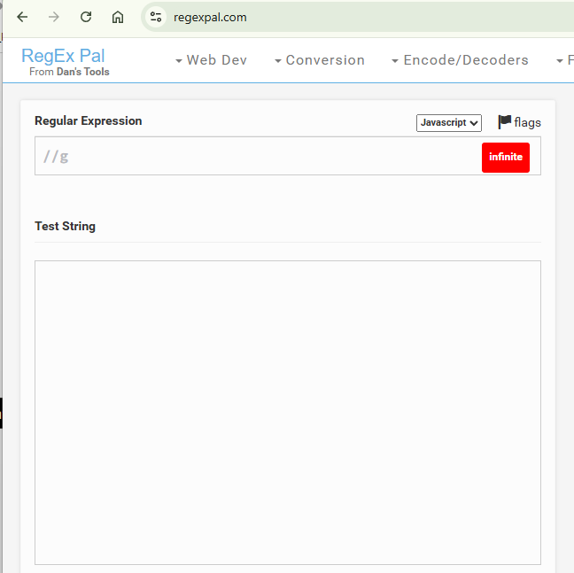
01. What is a Regular Expression? 01.01 Getting Started with Regexpal
002

Slide 3
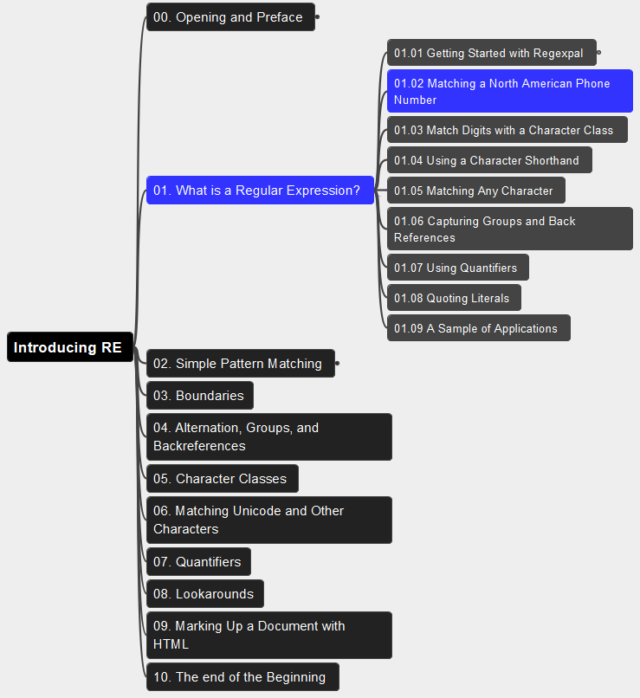
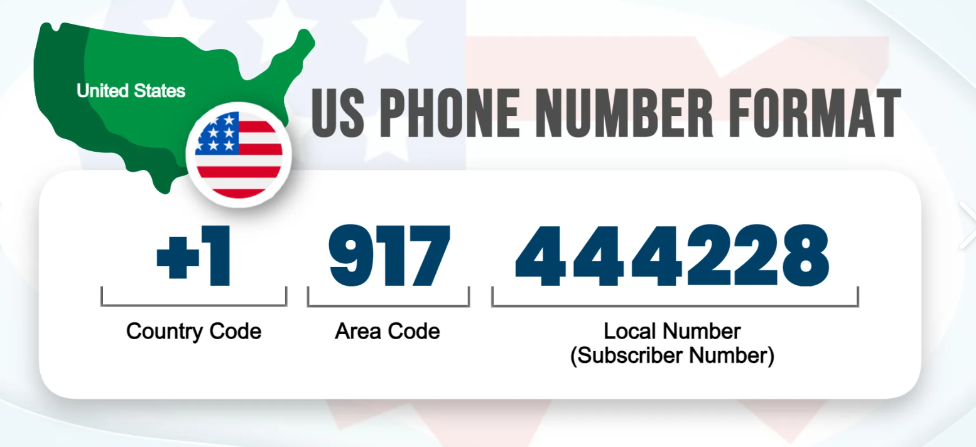
01. What is a Regular Expression? 01.02 Matching a North American Phone Number
003

Slide 4
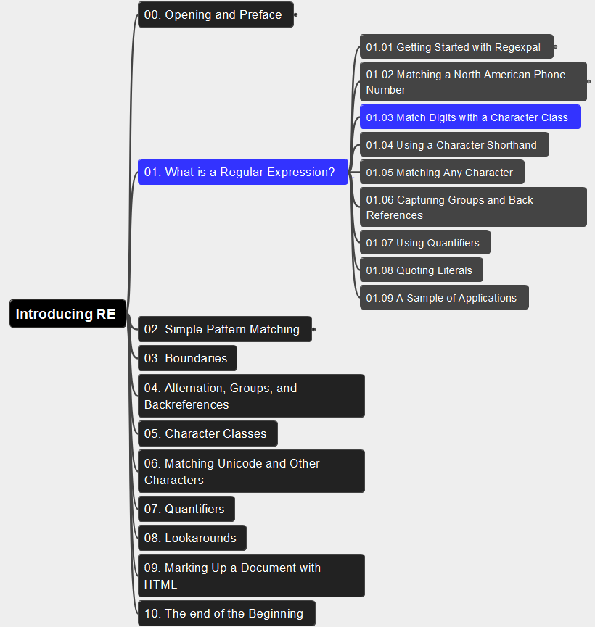
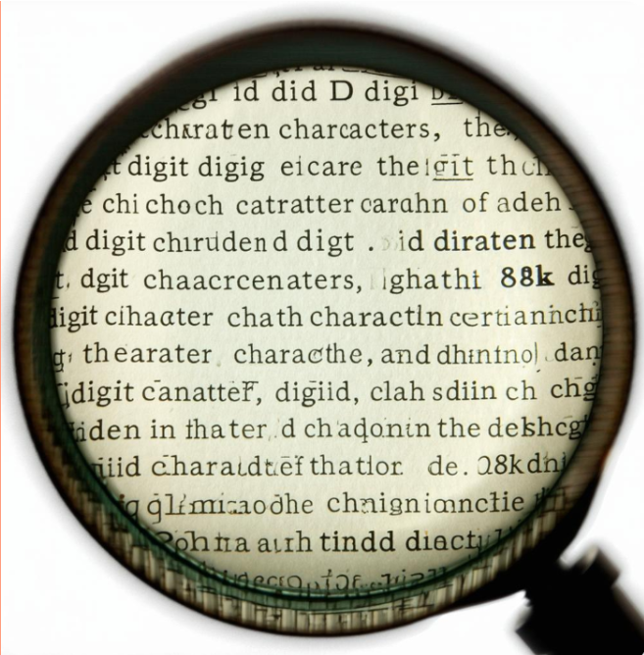
01. What is a Regular Expression? 01.03 Match Digits with a Character Class
004

Slide 5
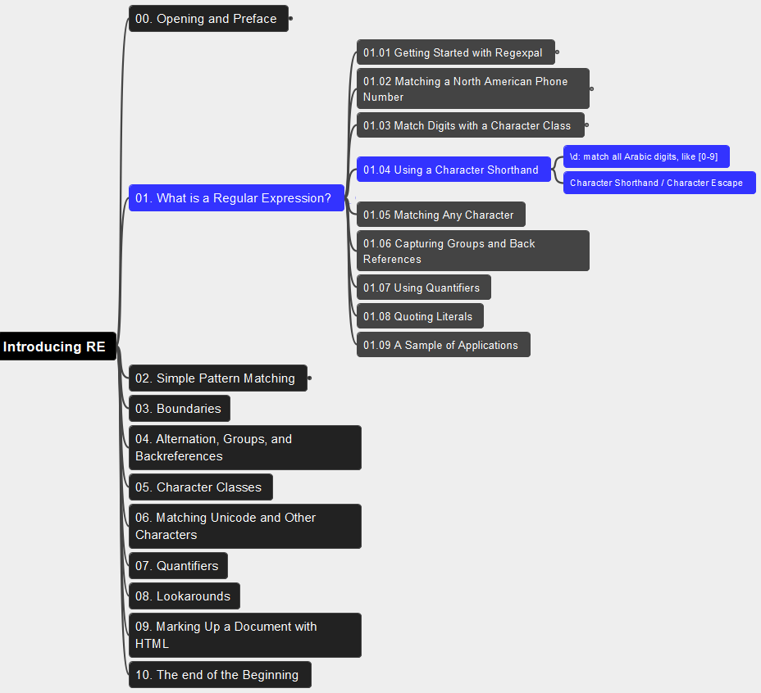
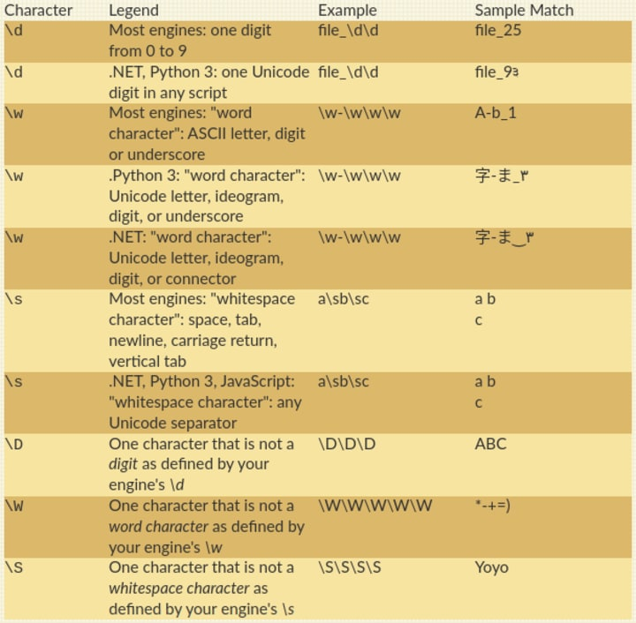
01. What is a Regular Expression? 01.04 Using a Character Shorthand
005

Slide 6
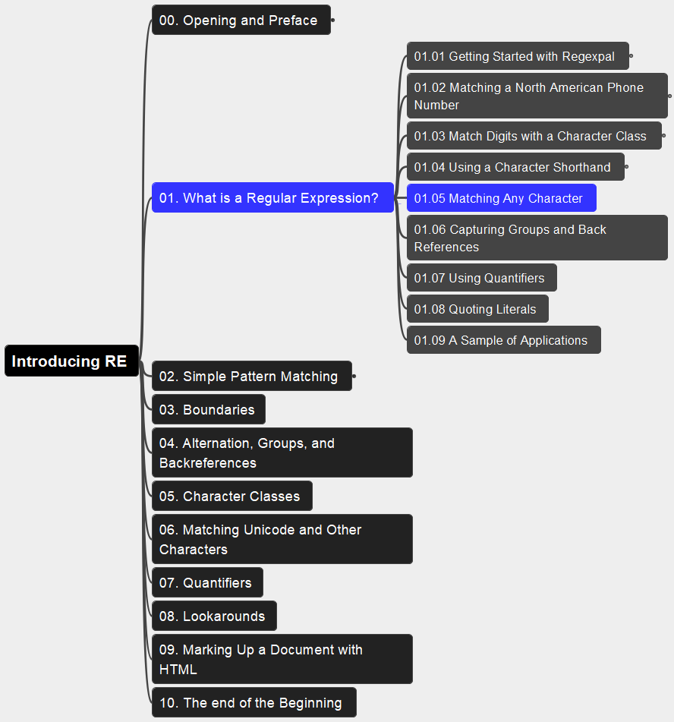
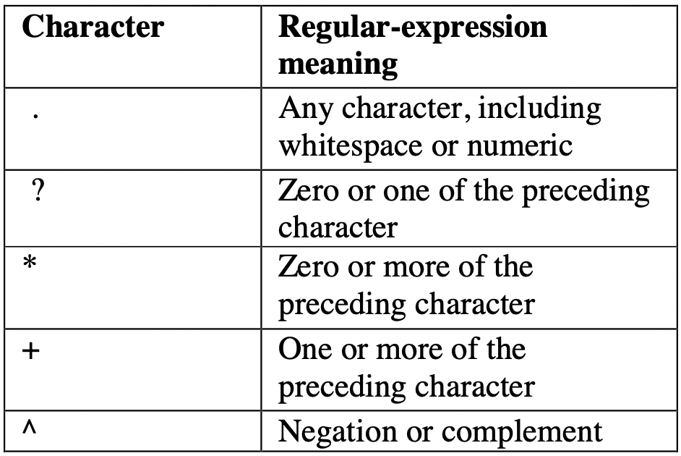
01. What is a Regular Expression? 01.05 Matching Any Character
006

Slide 7
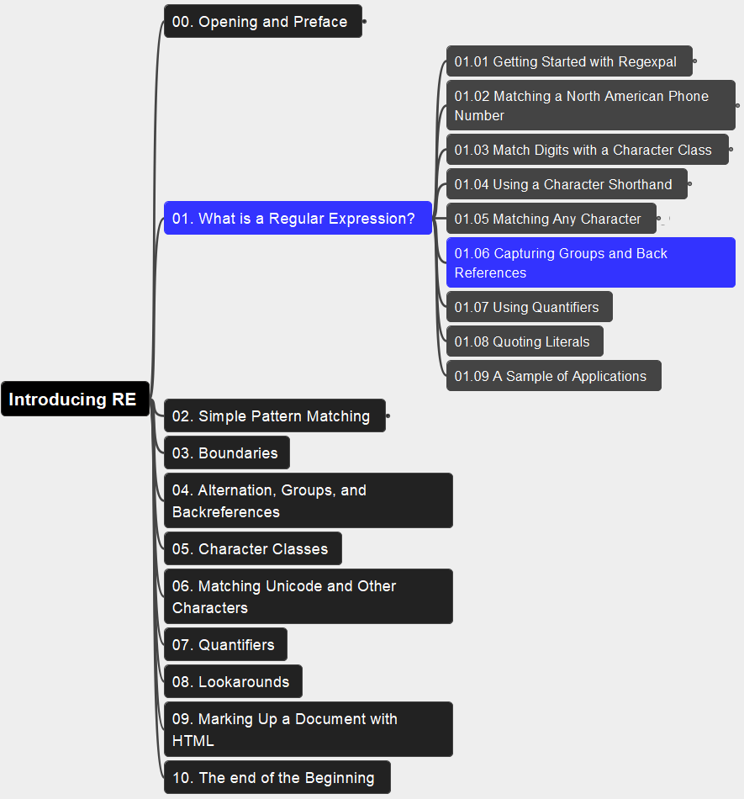
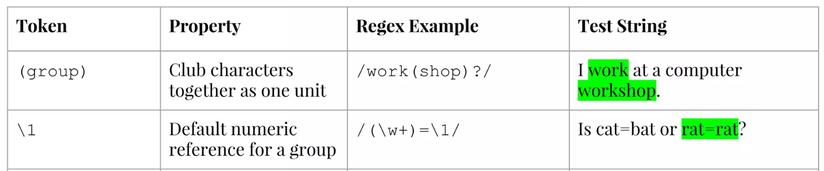
01. What is a Regular Expression? 01.06 Capturing Groups and Back References
007

Slide 8
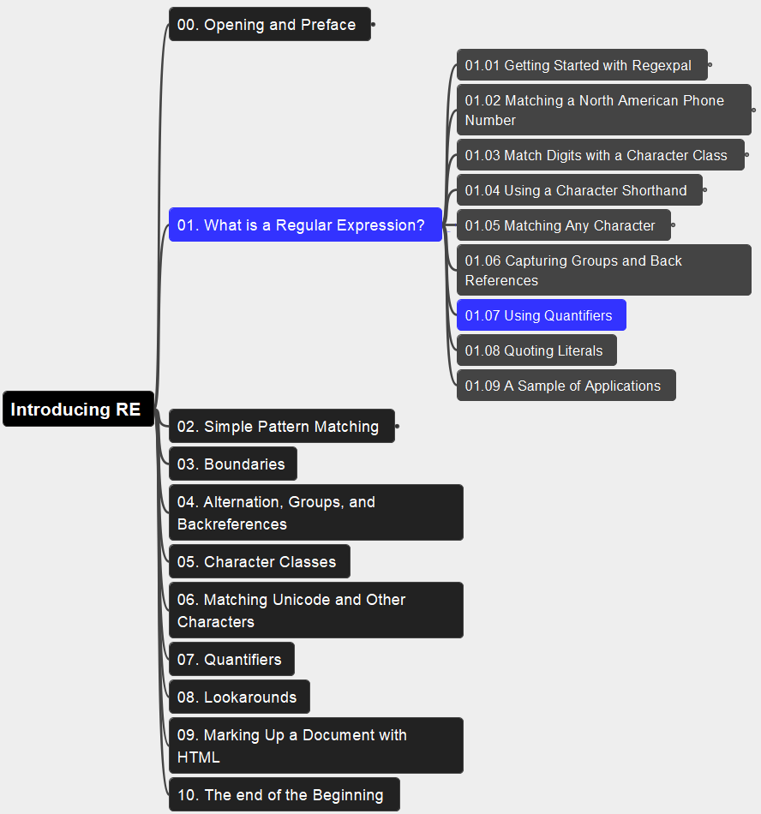
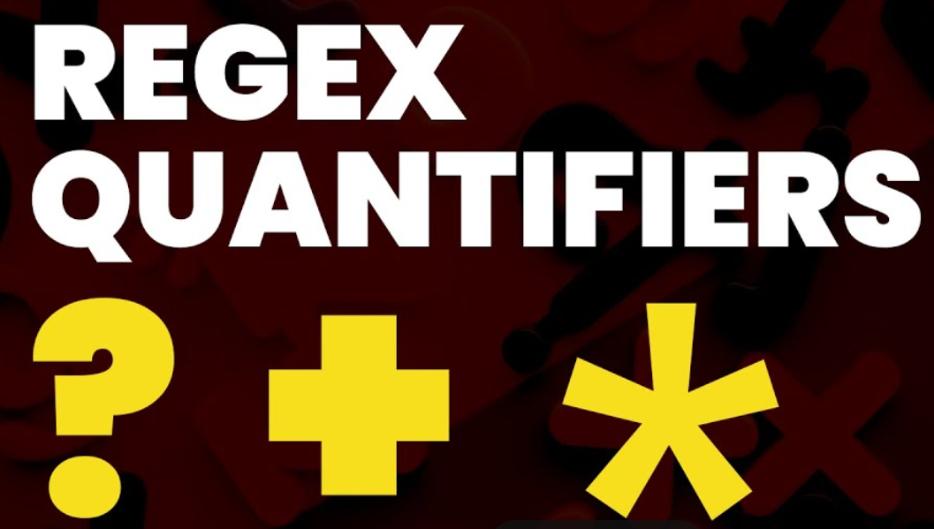
01. What is a Regular Expression? 01.07 Using Quantifiers
008

Slide 9
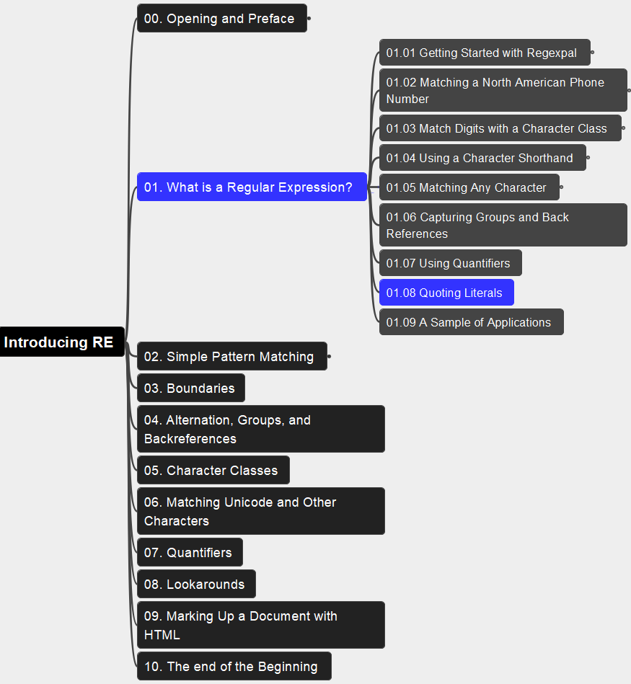
01. What is a Regular Expression? 01.08 Quoting Literals
009

Slide 10
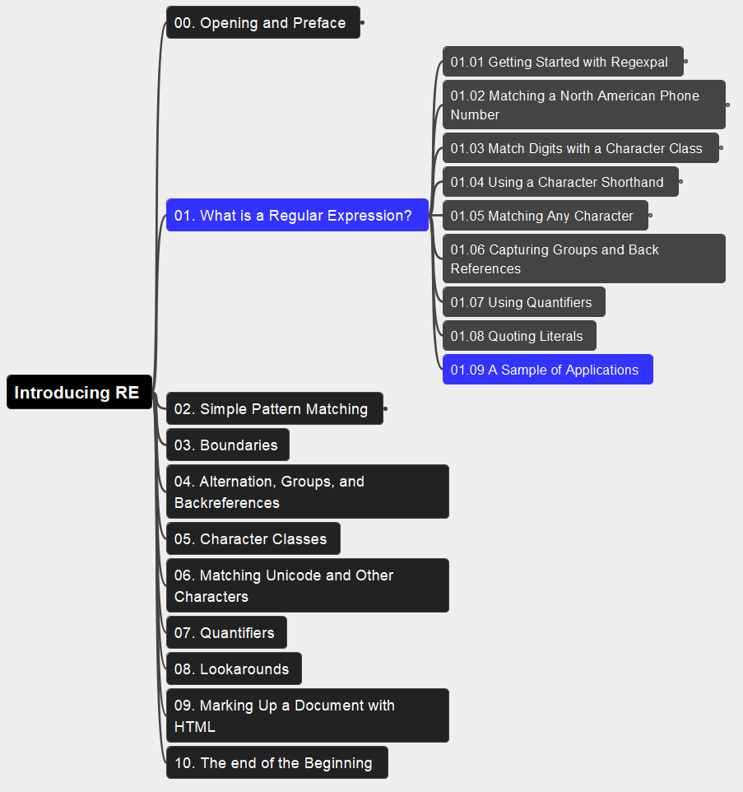
01. What is a Regular Expression? 01.09 A Sample of Applications
010

Slide 11
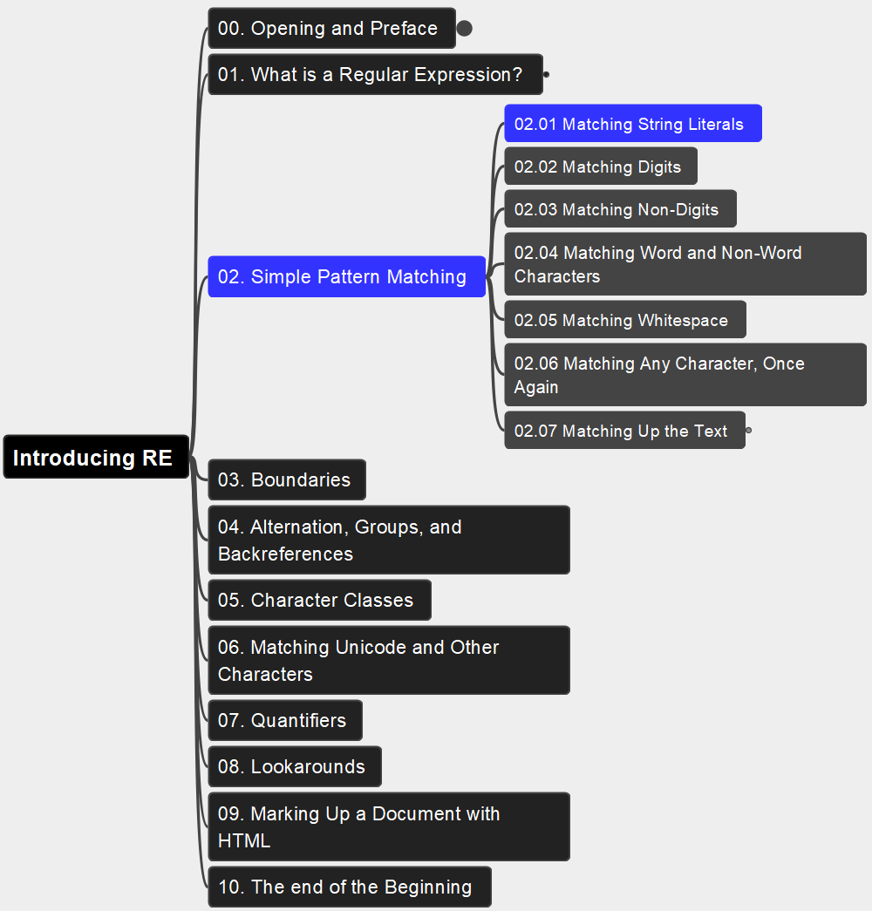
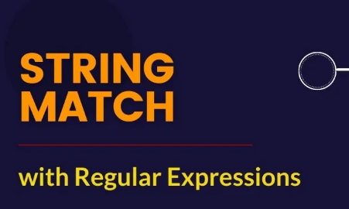
02. Simple Pattern Matching 02.01 Matching String Literals
011

Slide 12
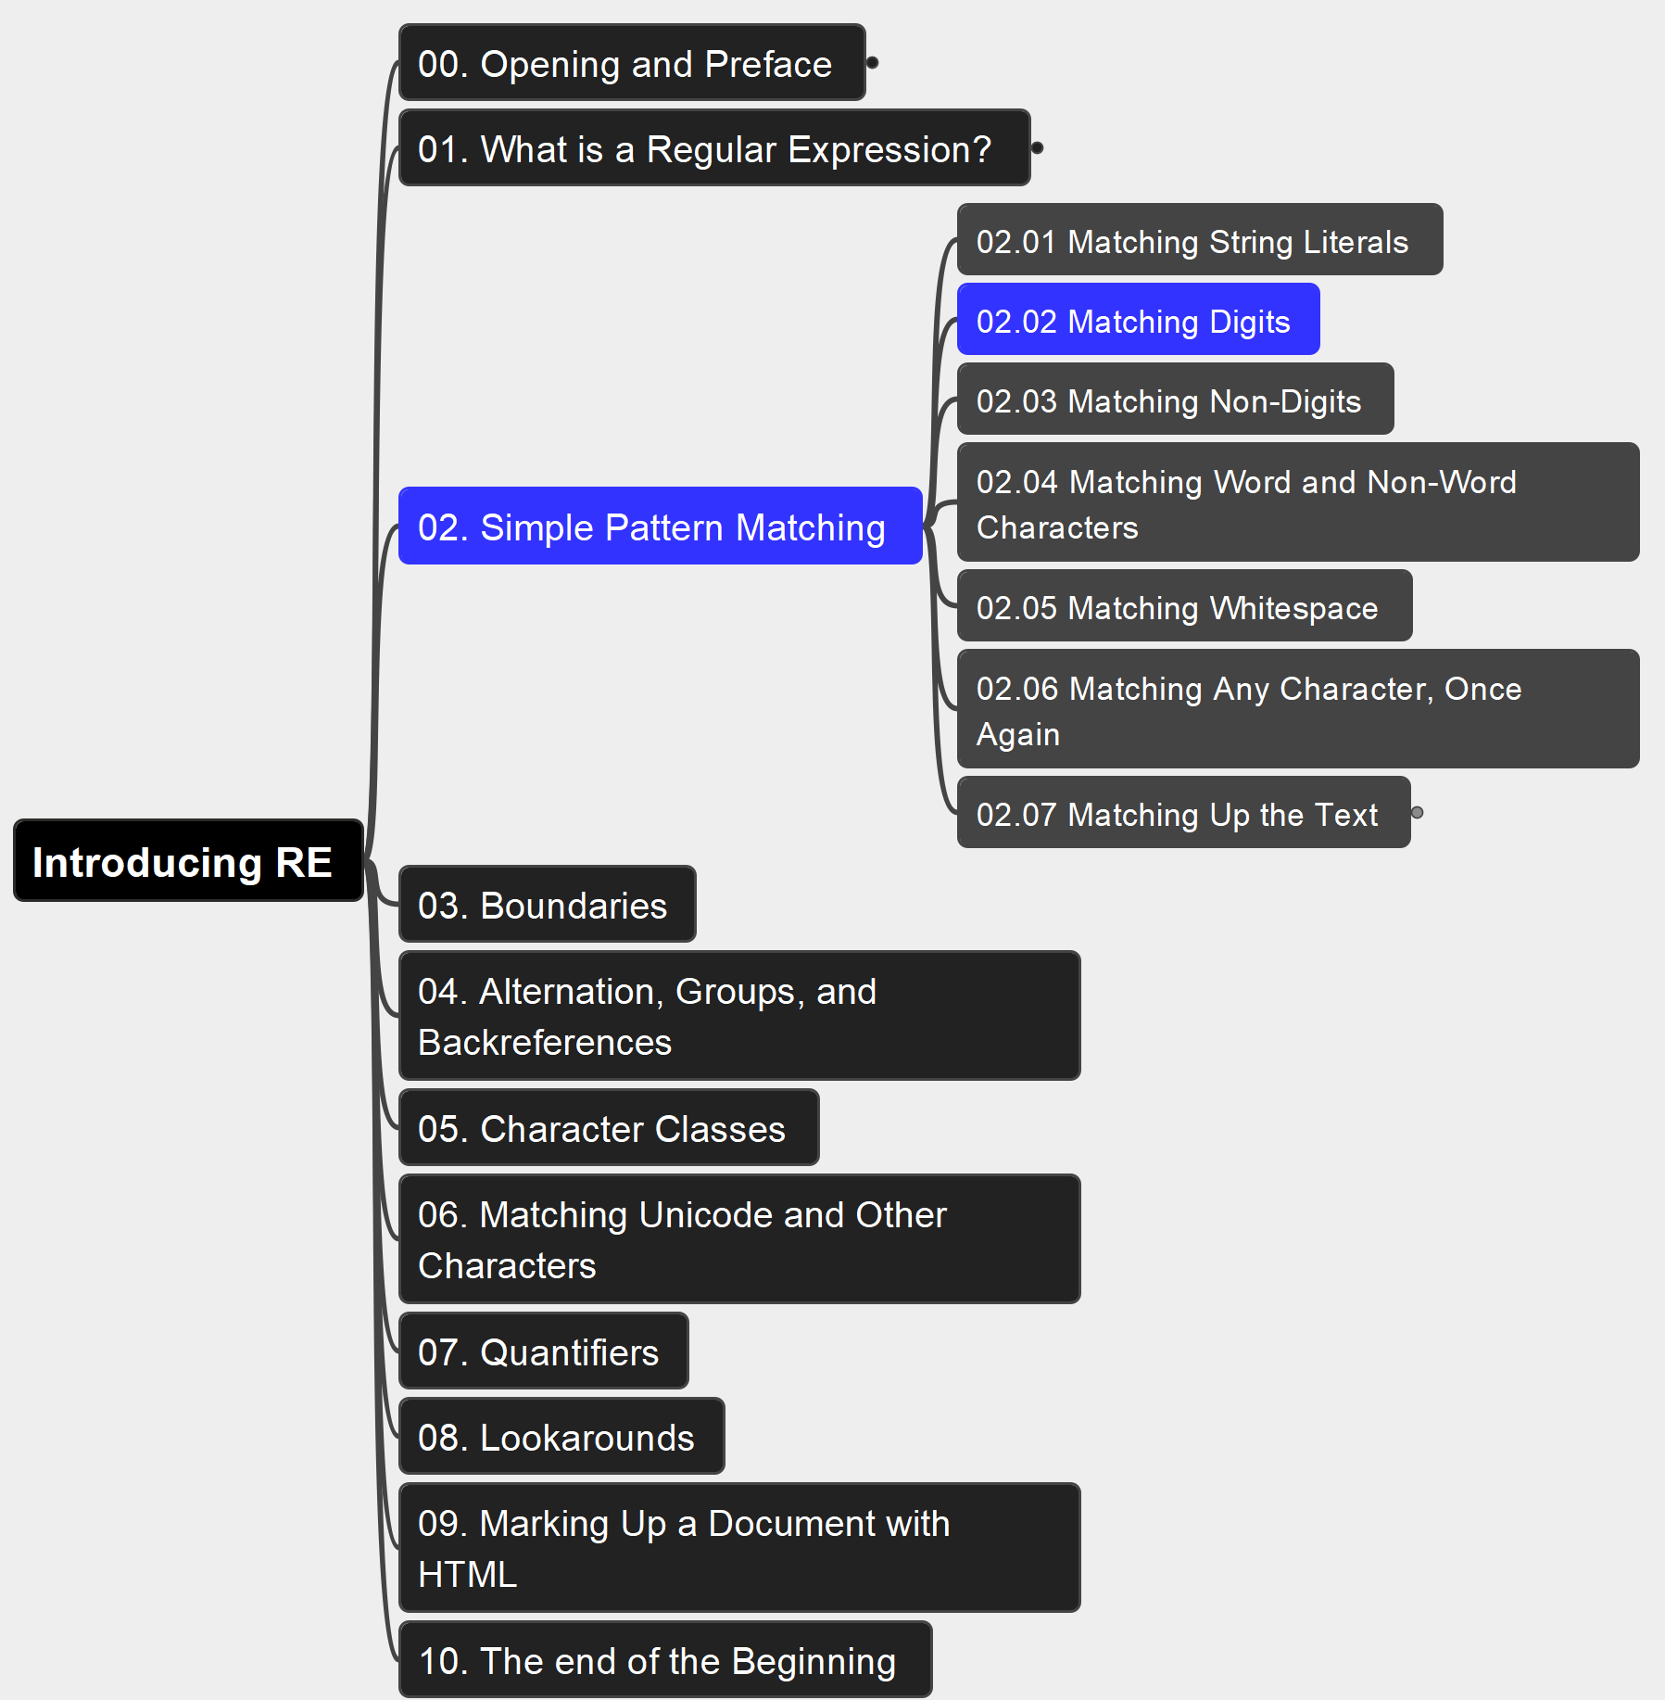
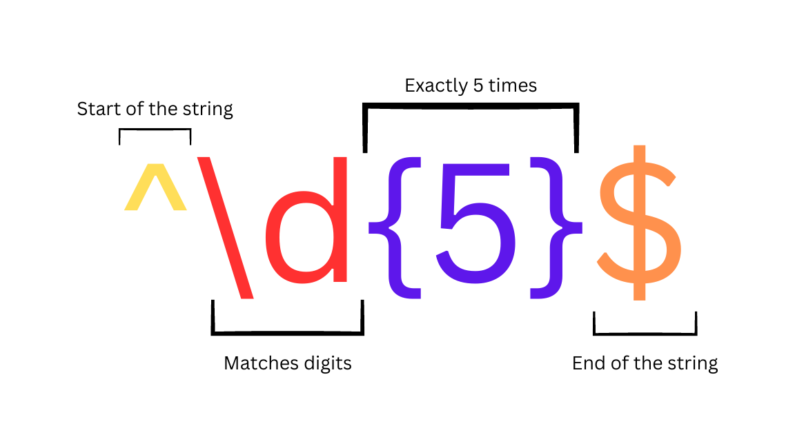
02. Simple Pattern Matching 02.02 Matching Digits
012

Slide 13
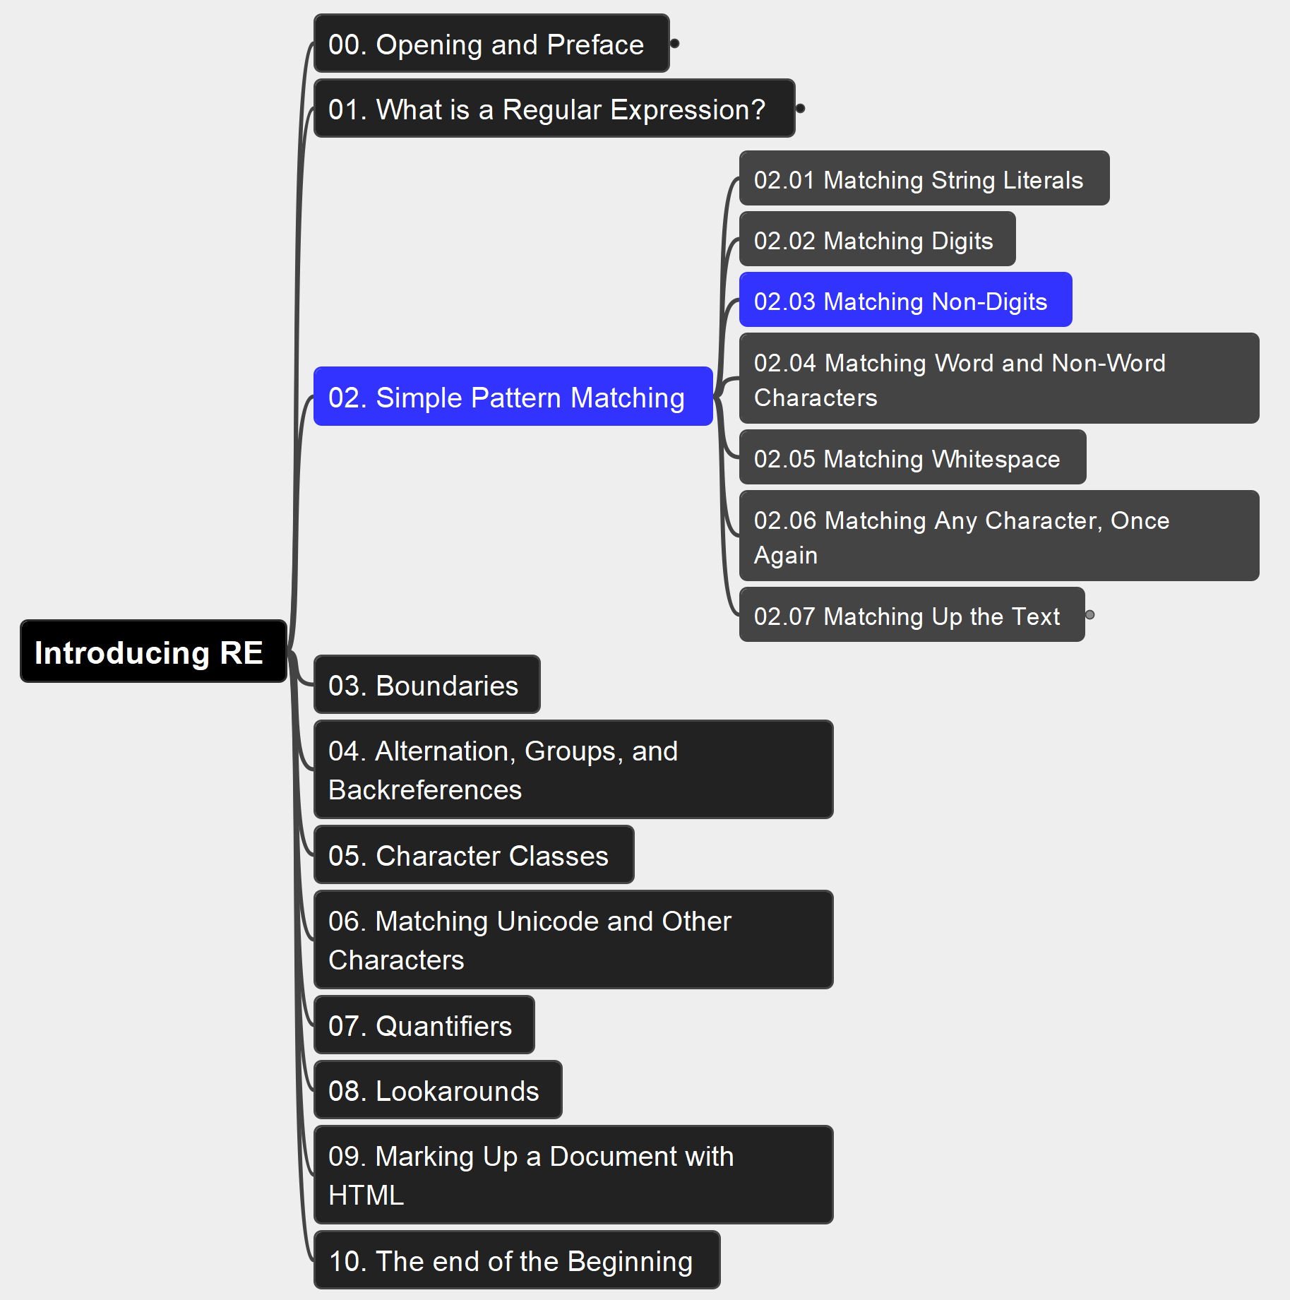
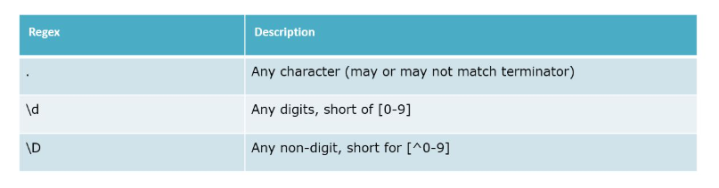
02. Simple Pattern Matching 02.03 Matching Non-Digits
013

Slide 14
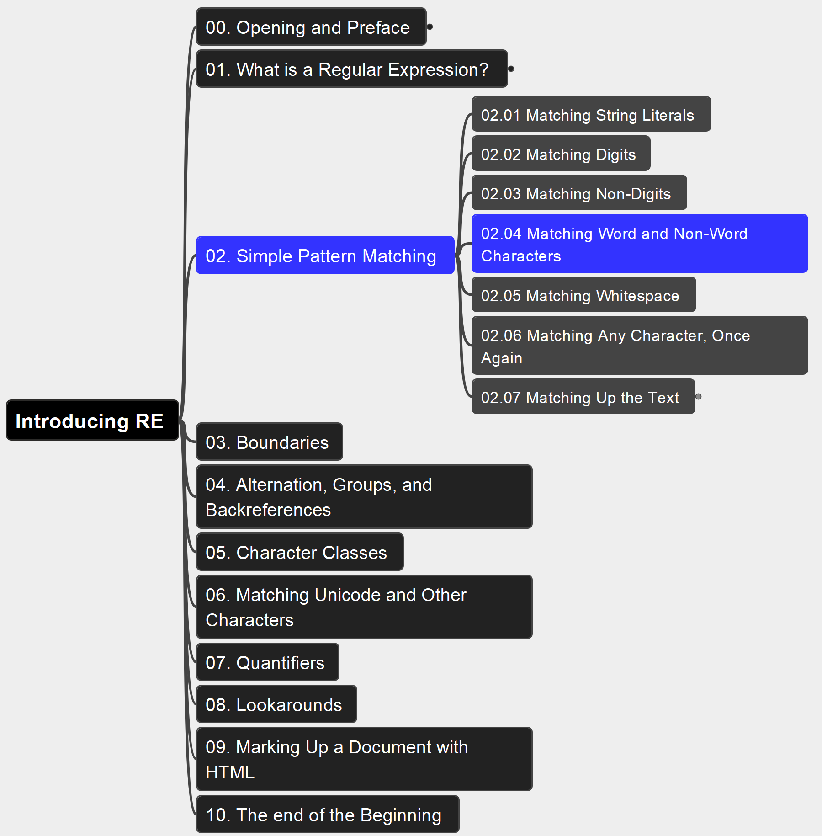
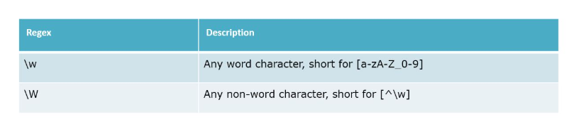
02. Simple Pattern Matching 02.04 Matching Word and Non-Word Characters
014

Slide 15
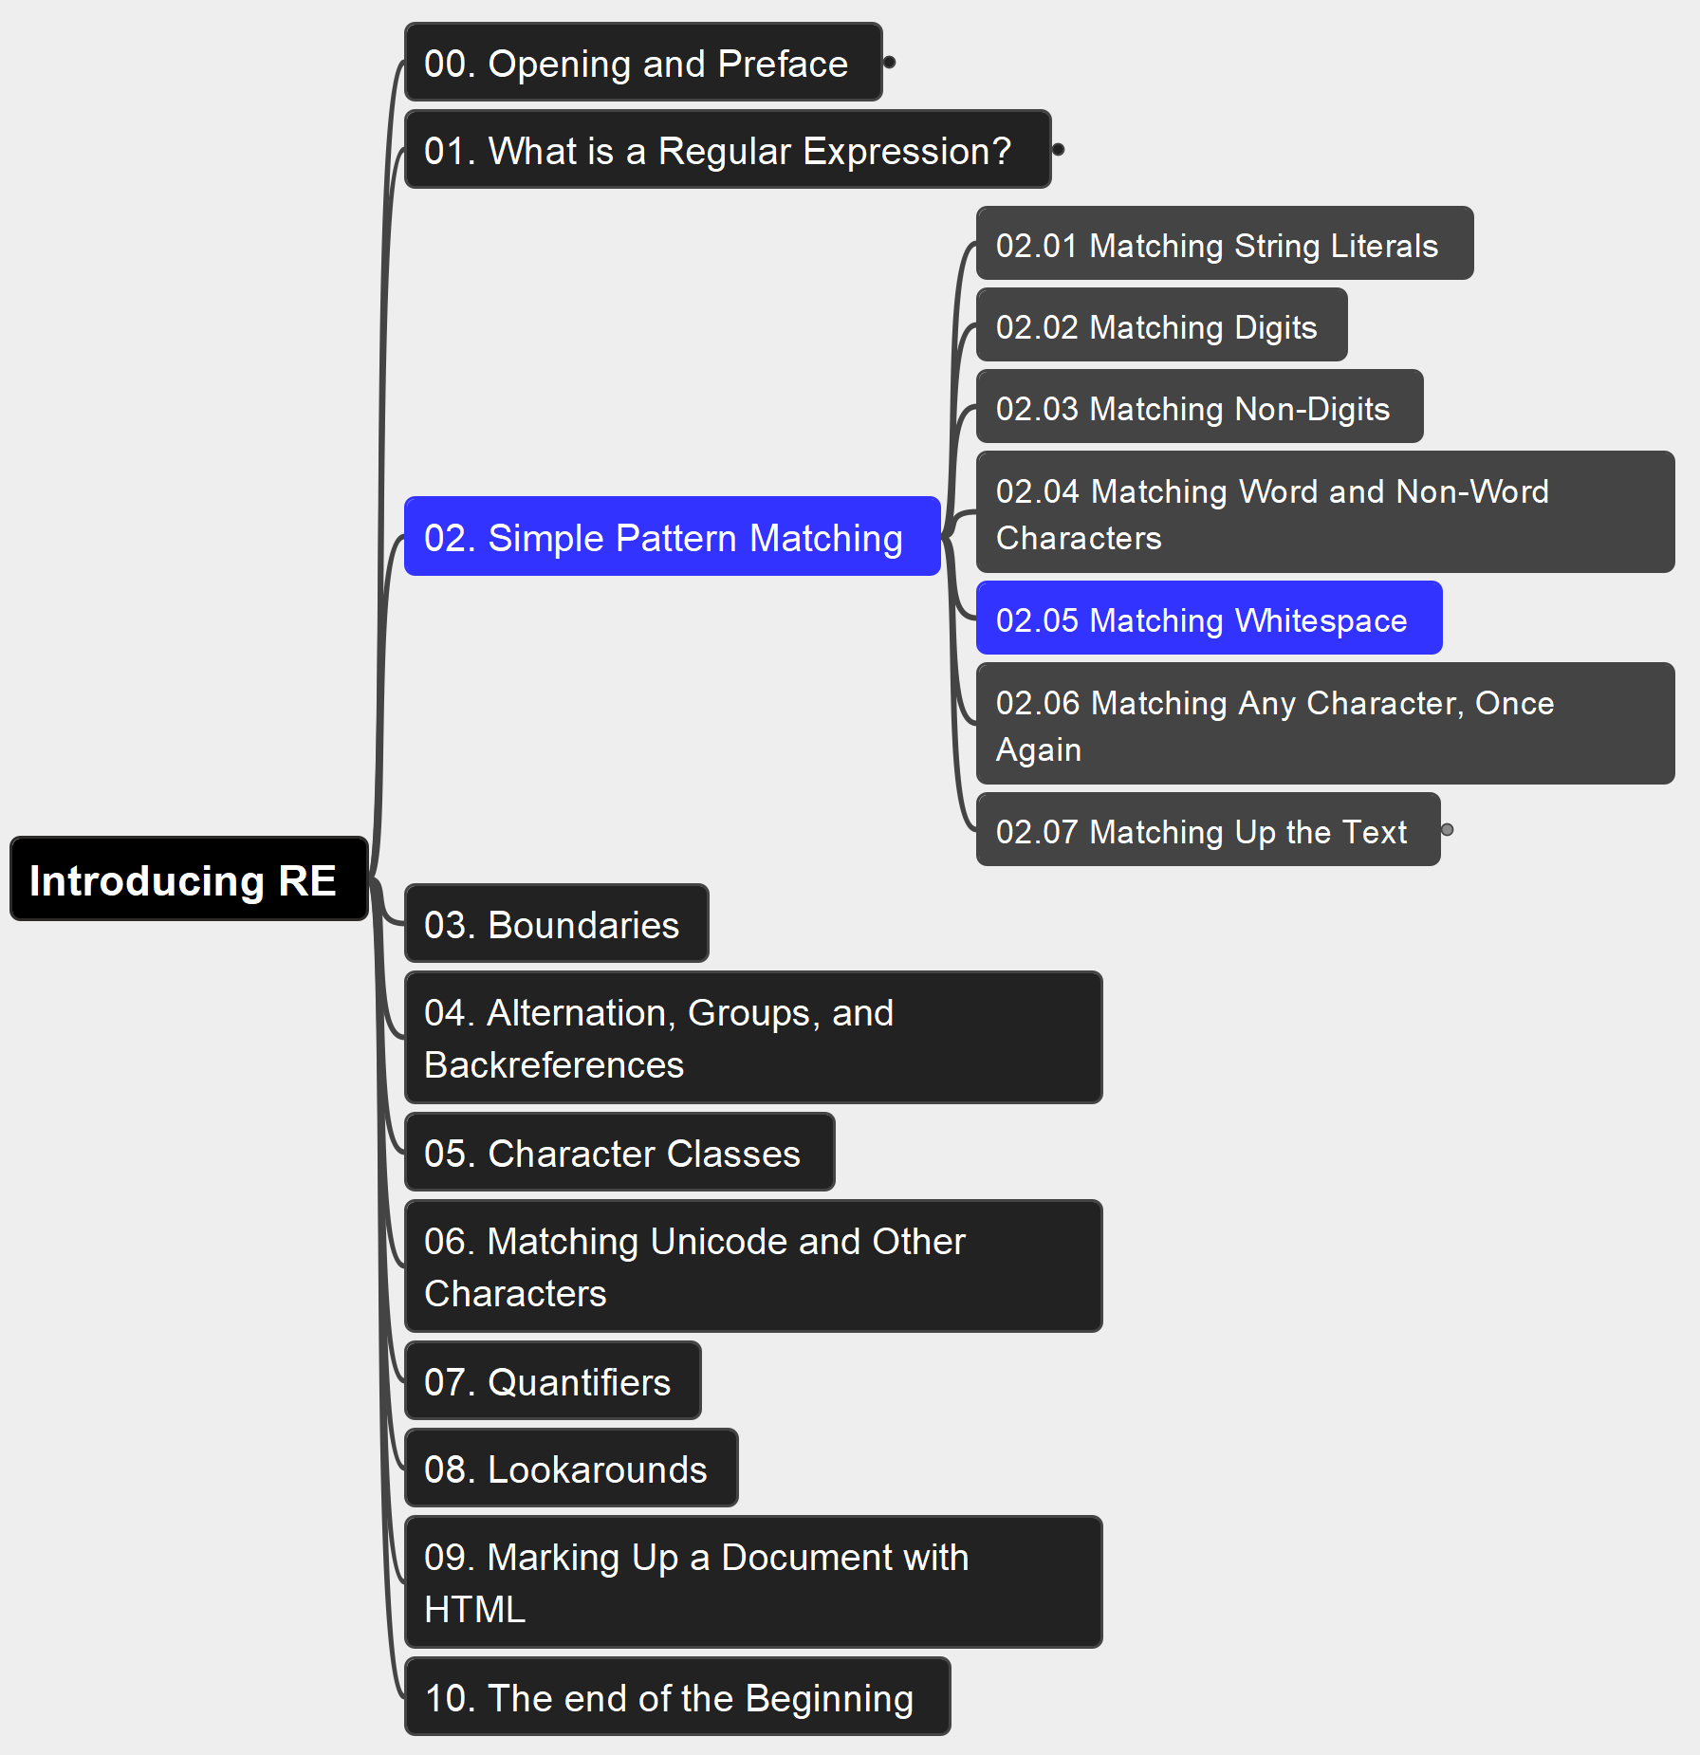
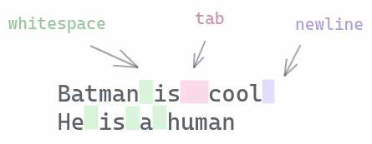
02. Simple Pattern Matching 02.05 Matching Whitespace
015

Slide 16
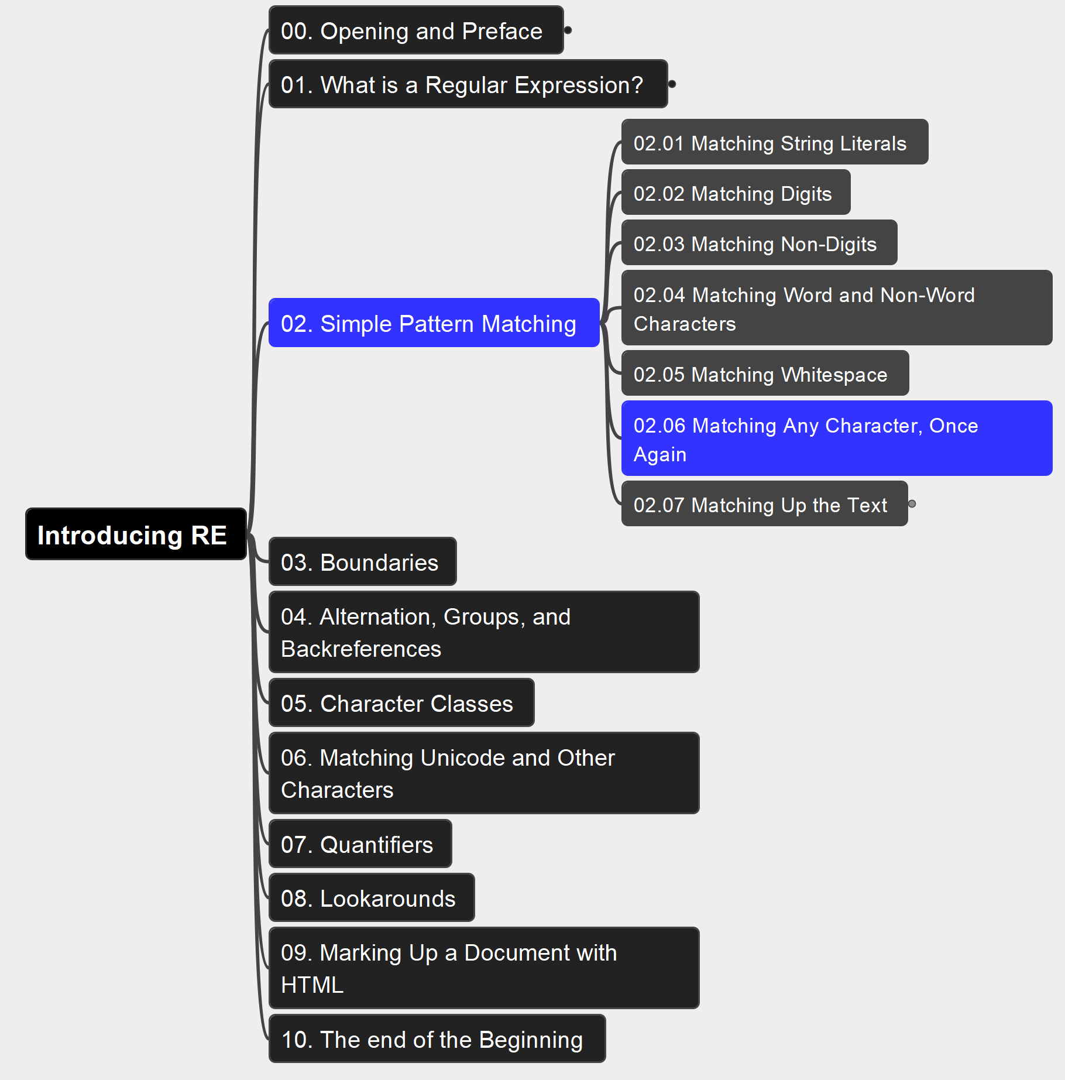
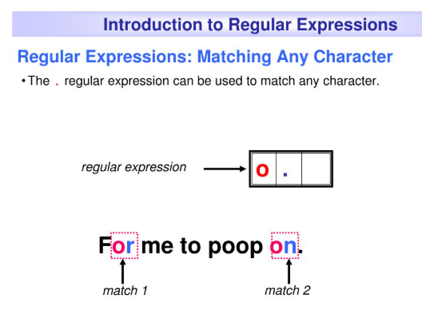
02. Simple Pattern Matching 02.06 Matching Any Character, Once Again
016

Slide 17
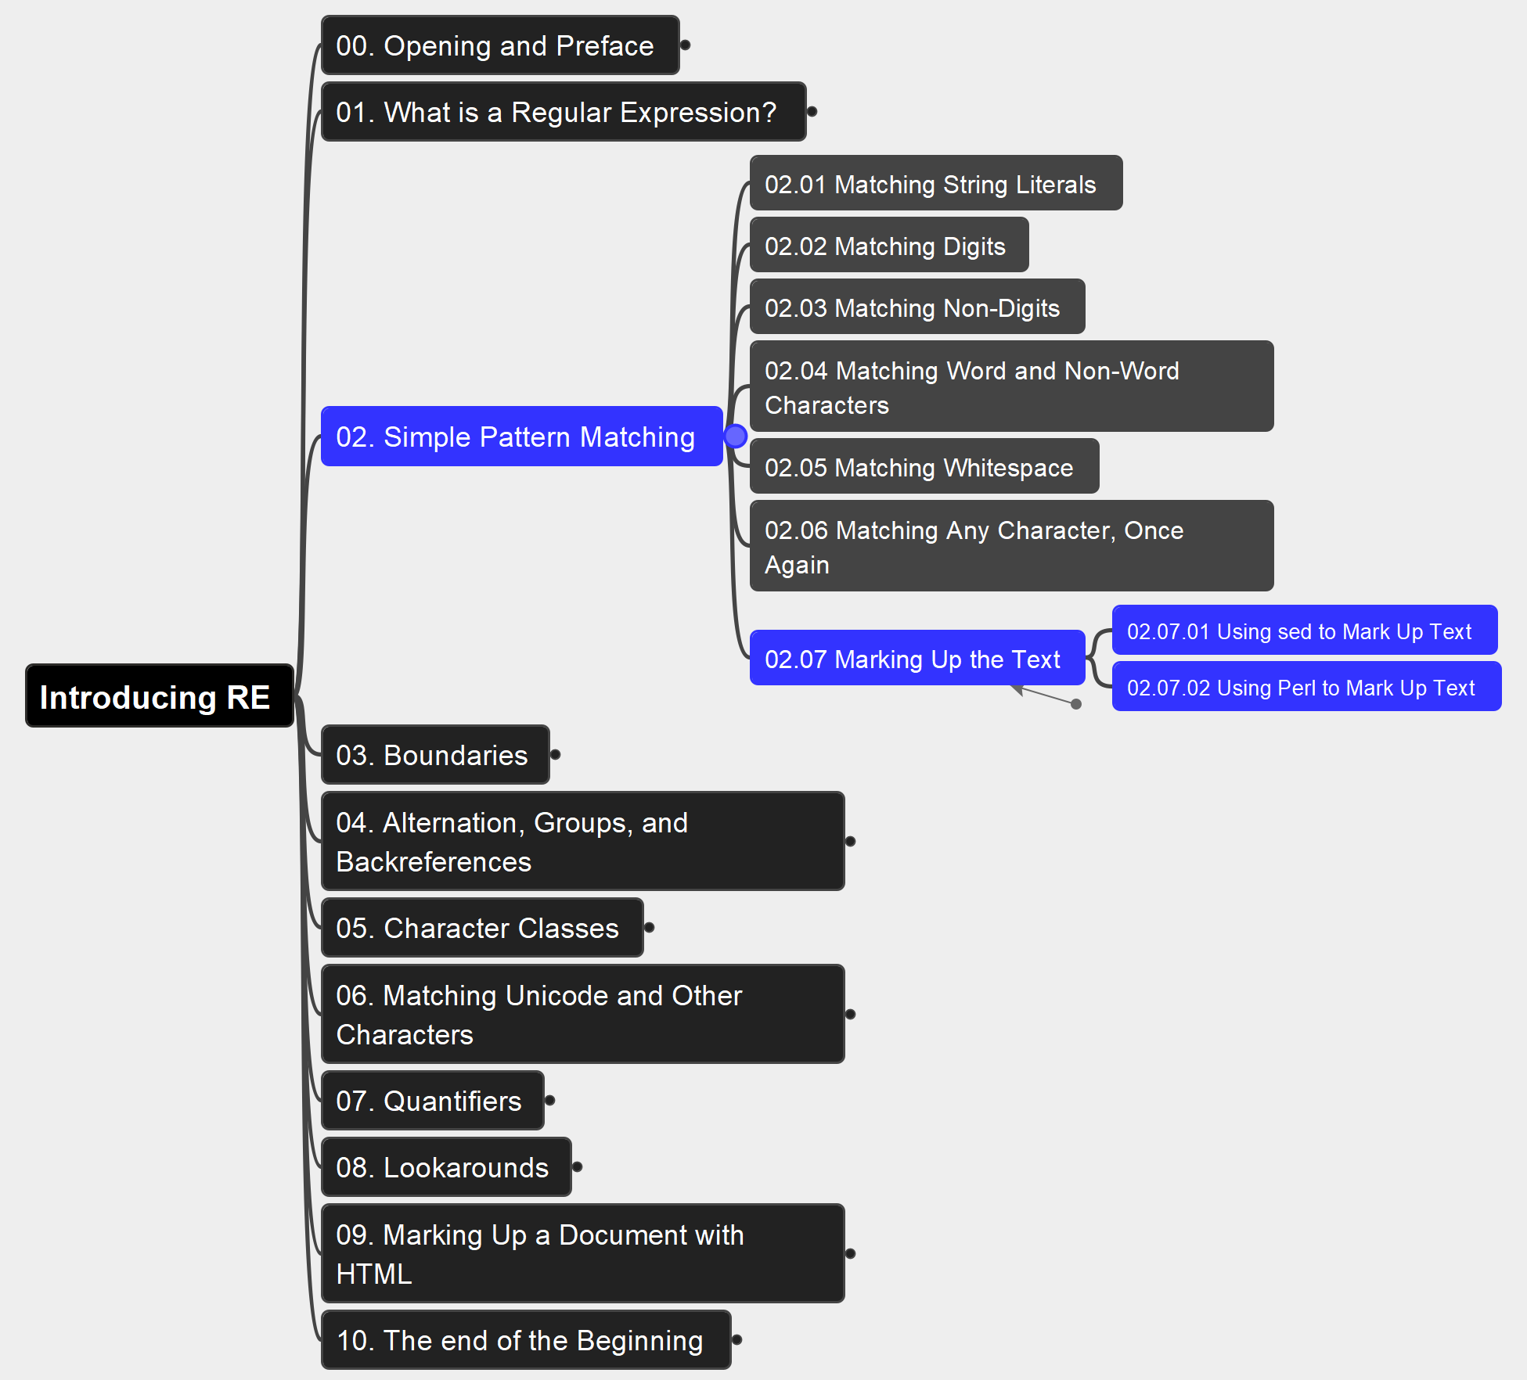
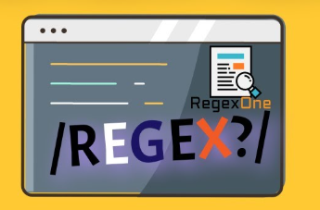
02. Simple Pattern Matching 02.07 Marking Up the Text
017

Slide 18
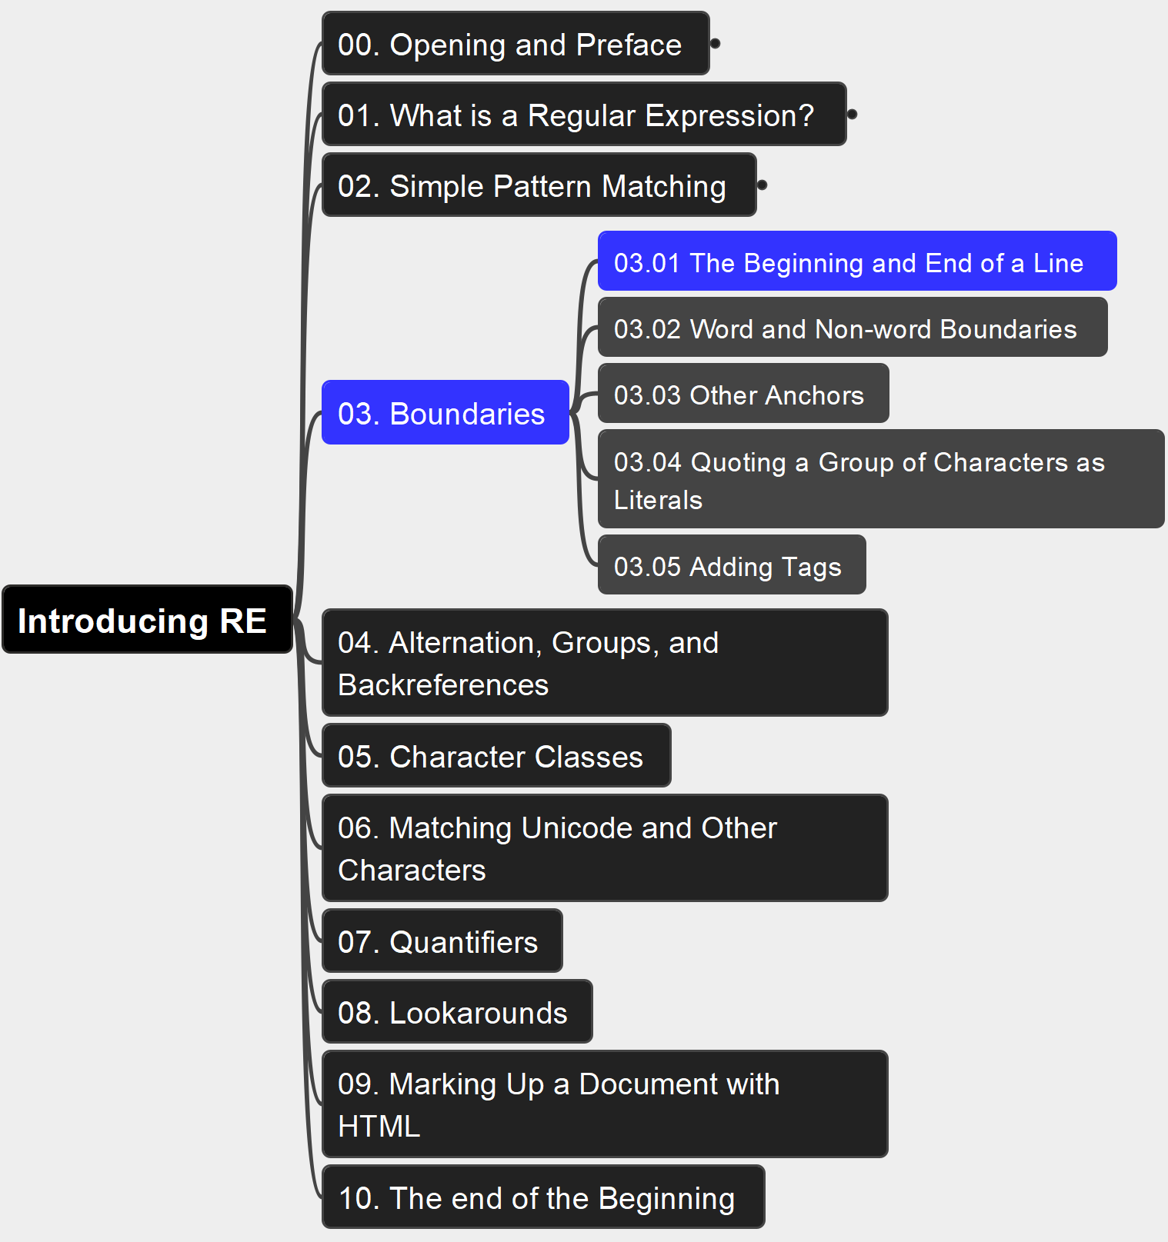
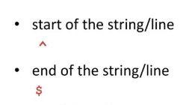
03. Boundaries 03.01 The Beginning and End of a Line
018

Slide 19
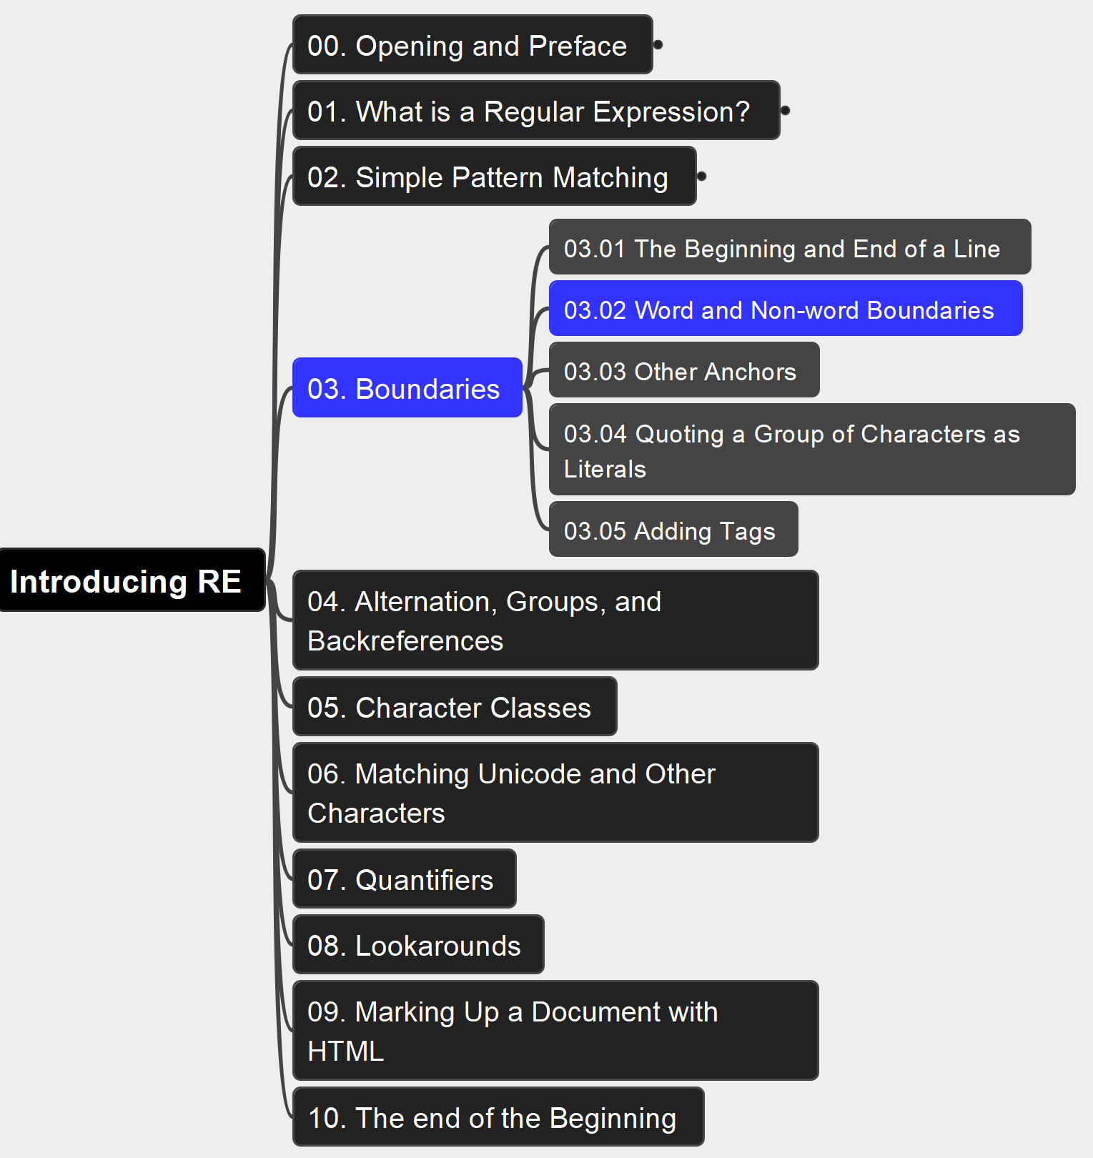
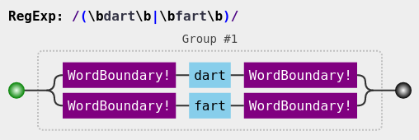
03. Boundaries 03.02 Word and Non-word Boundaries
019

Slide 20
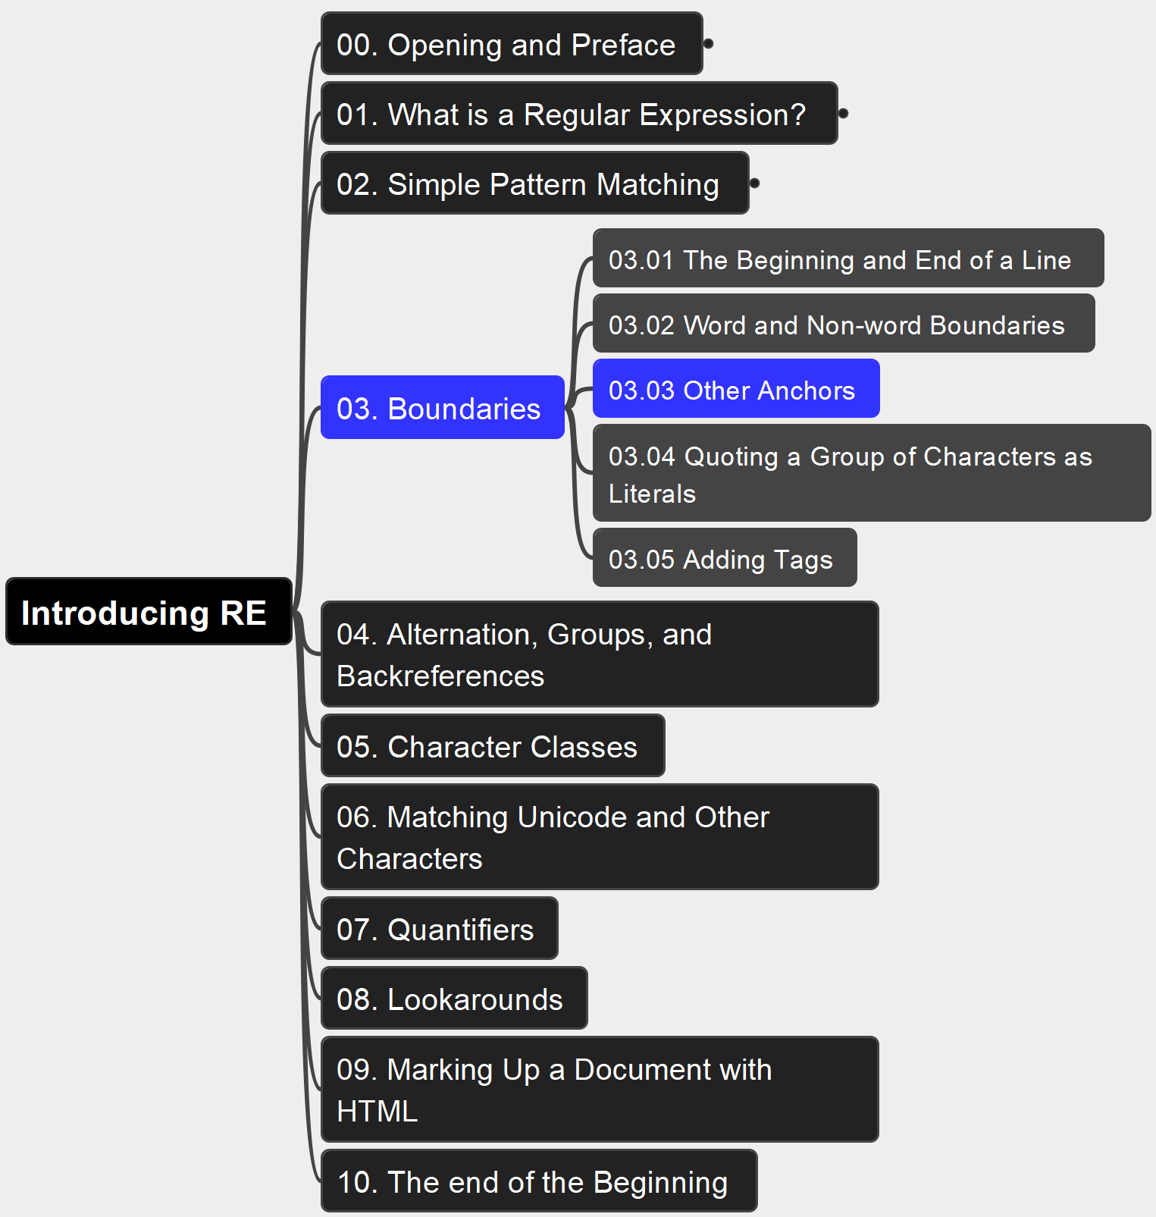
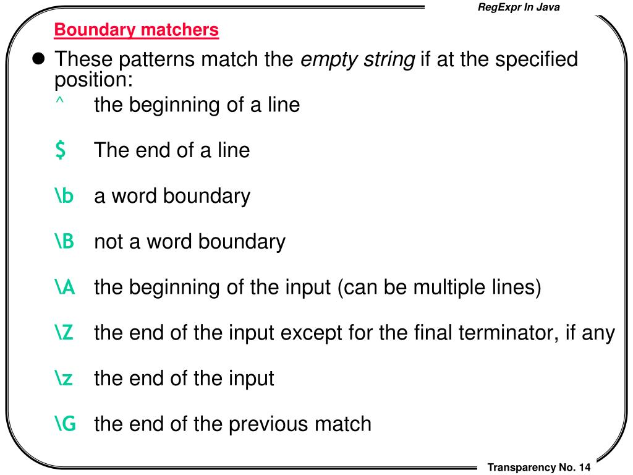
03. Boundaries 03.03 Other Anchors
020

Slide 21
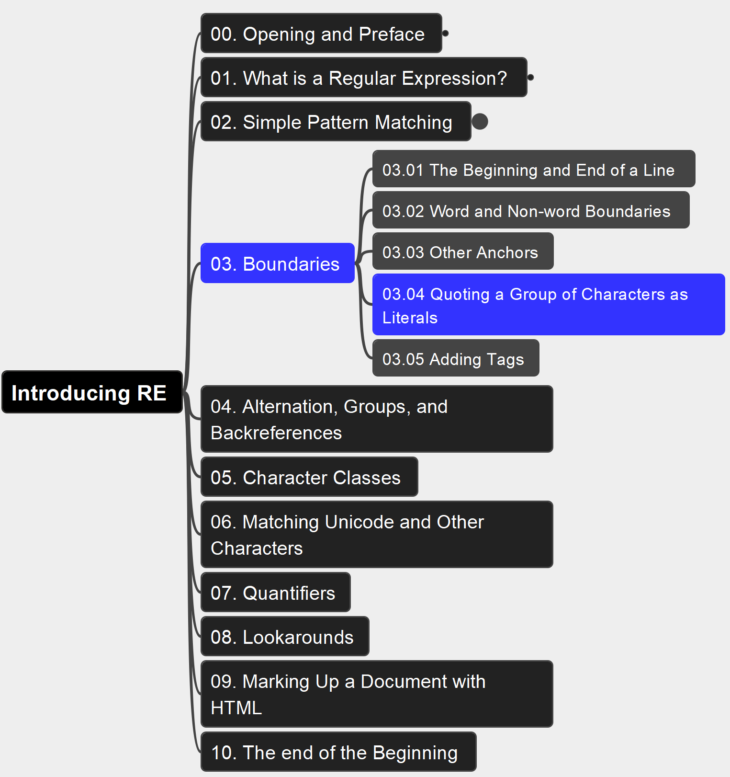

03. Boundaries 03.04 Quoting a Group of Chars as Literals
021

Slide 22
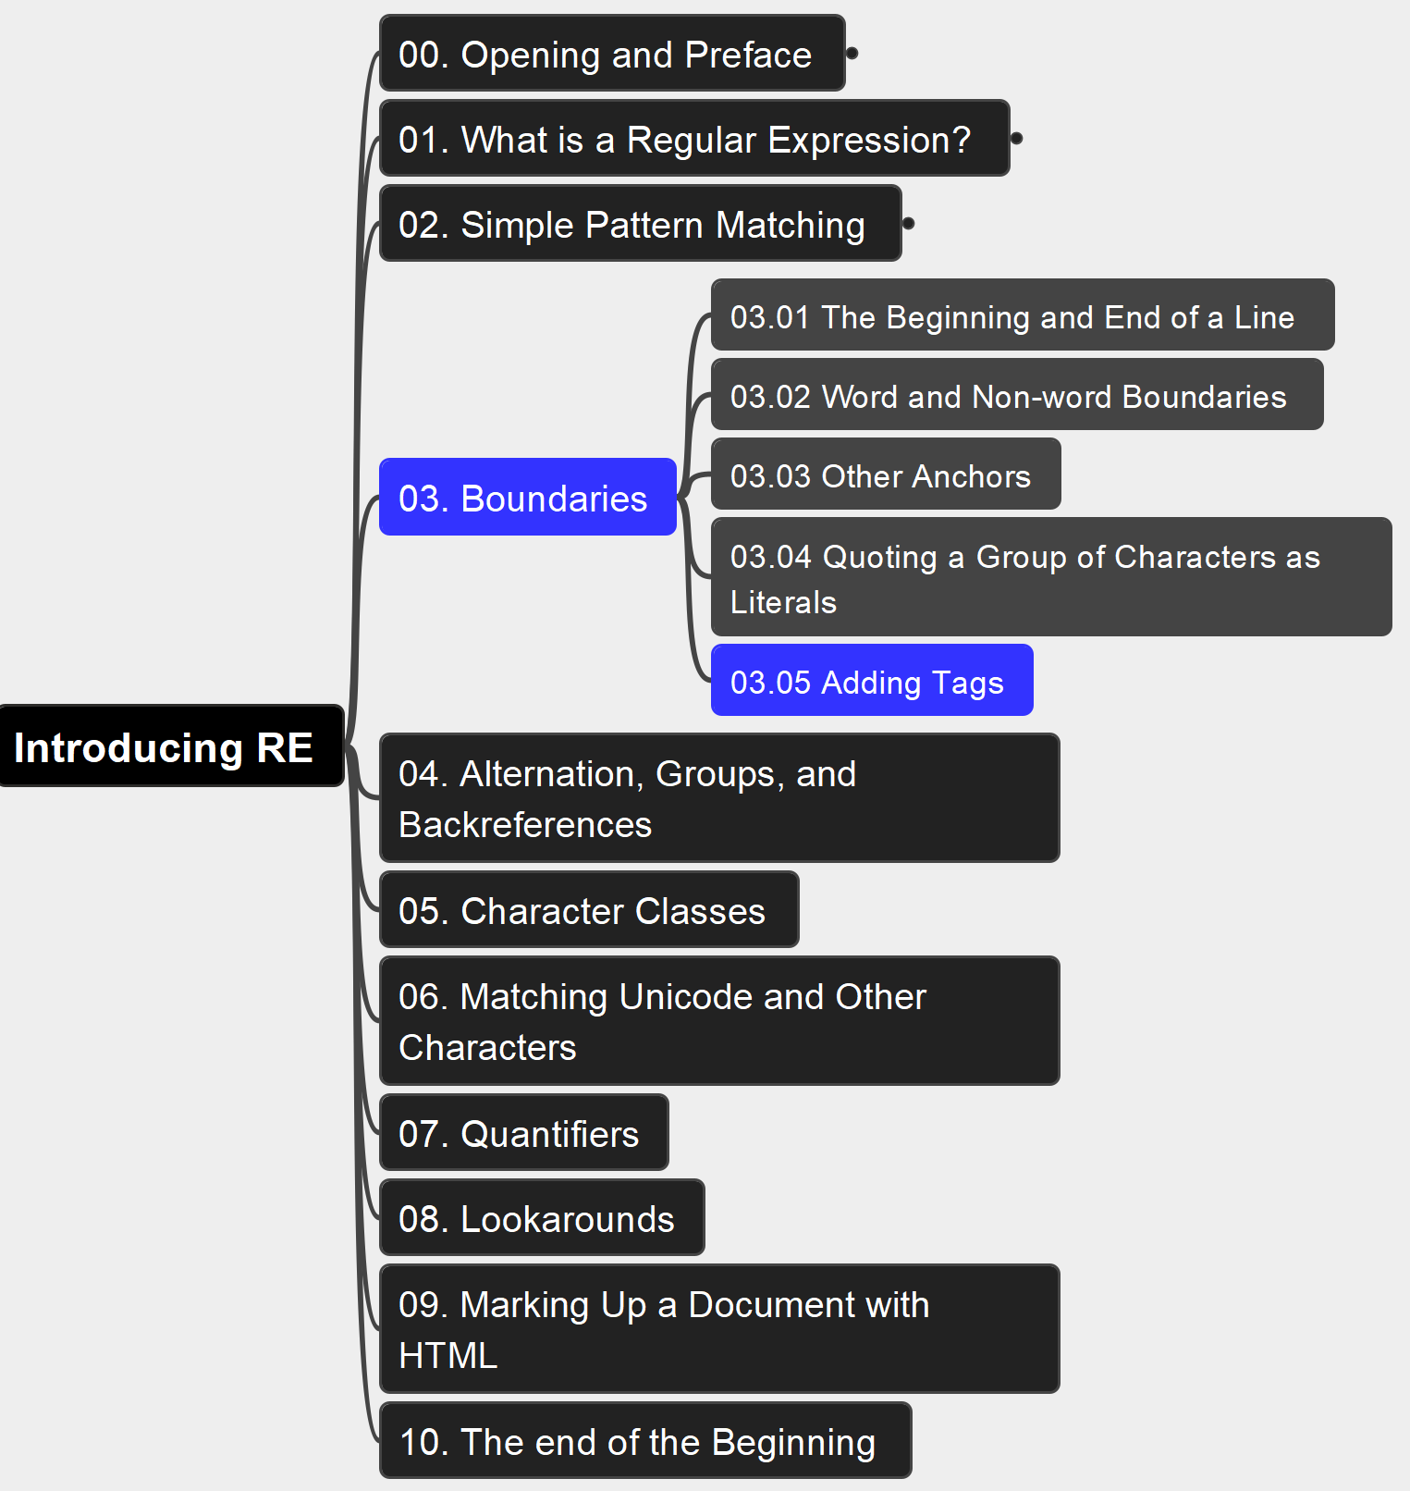
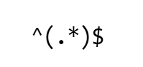
03. Boundaries 03.05 Adding Tags
022

Slide 23
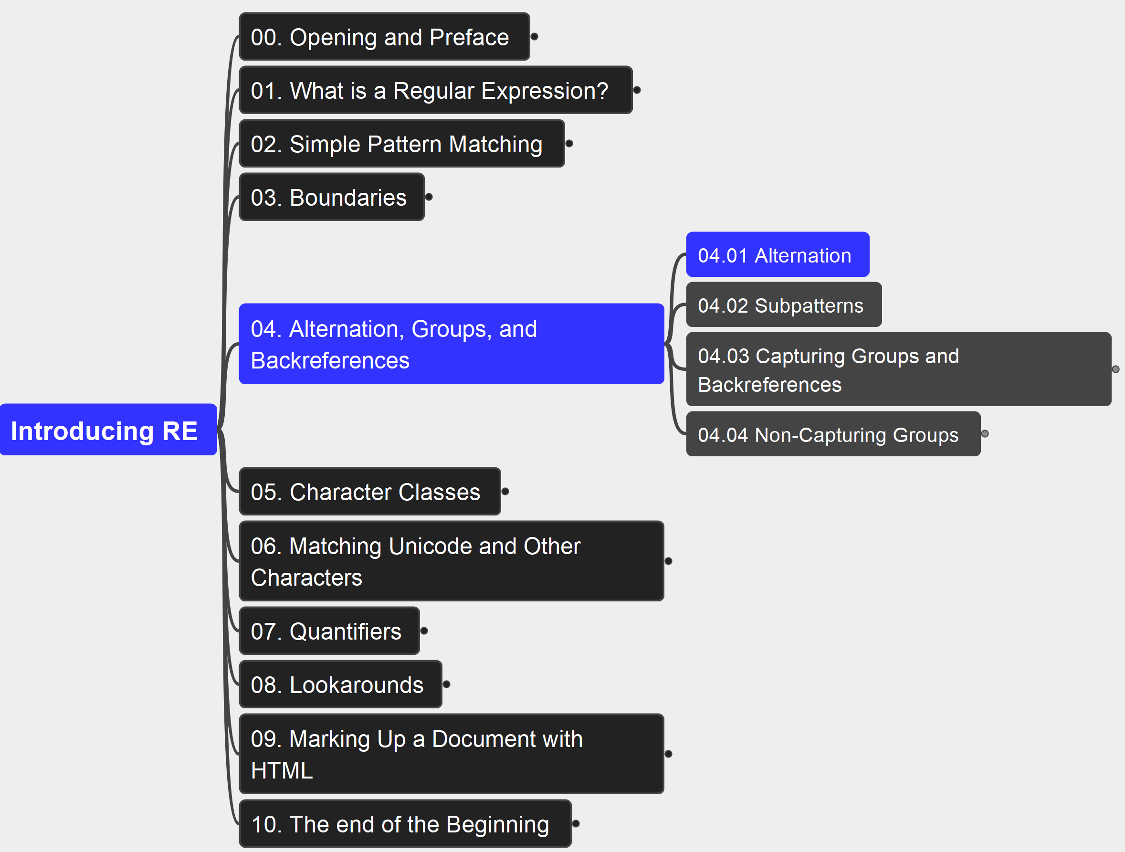
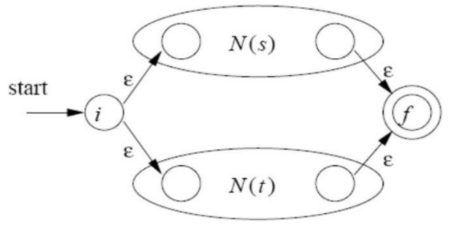
04. Alternation, Groups, and Backreferences 04.01 Alternation
023

Slide 24
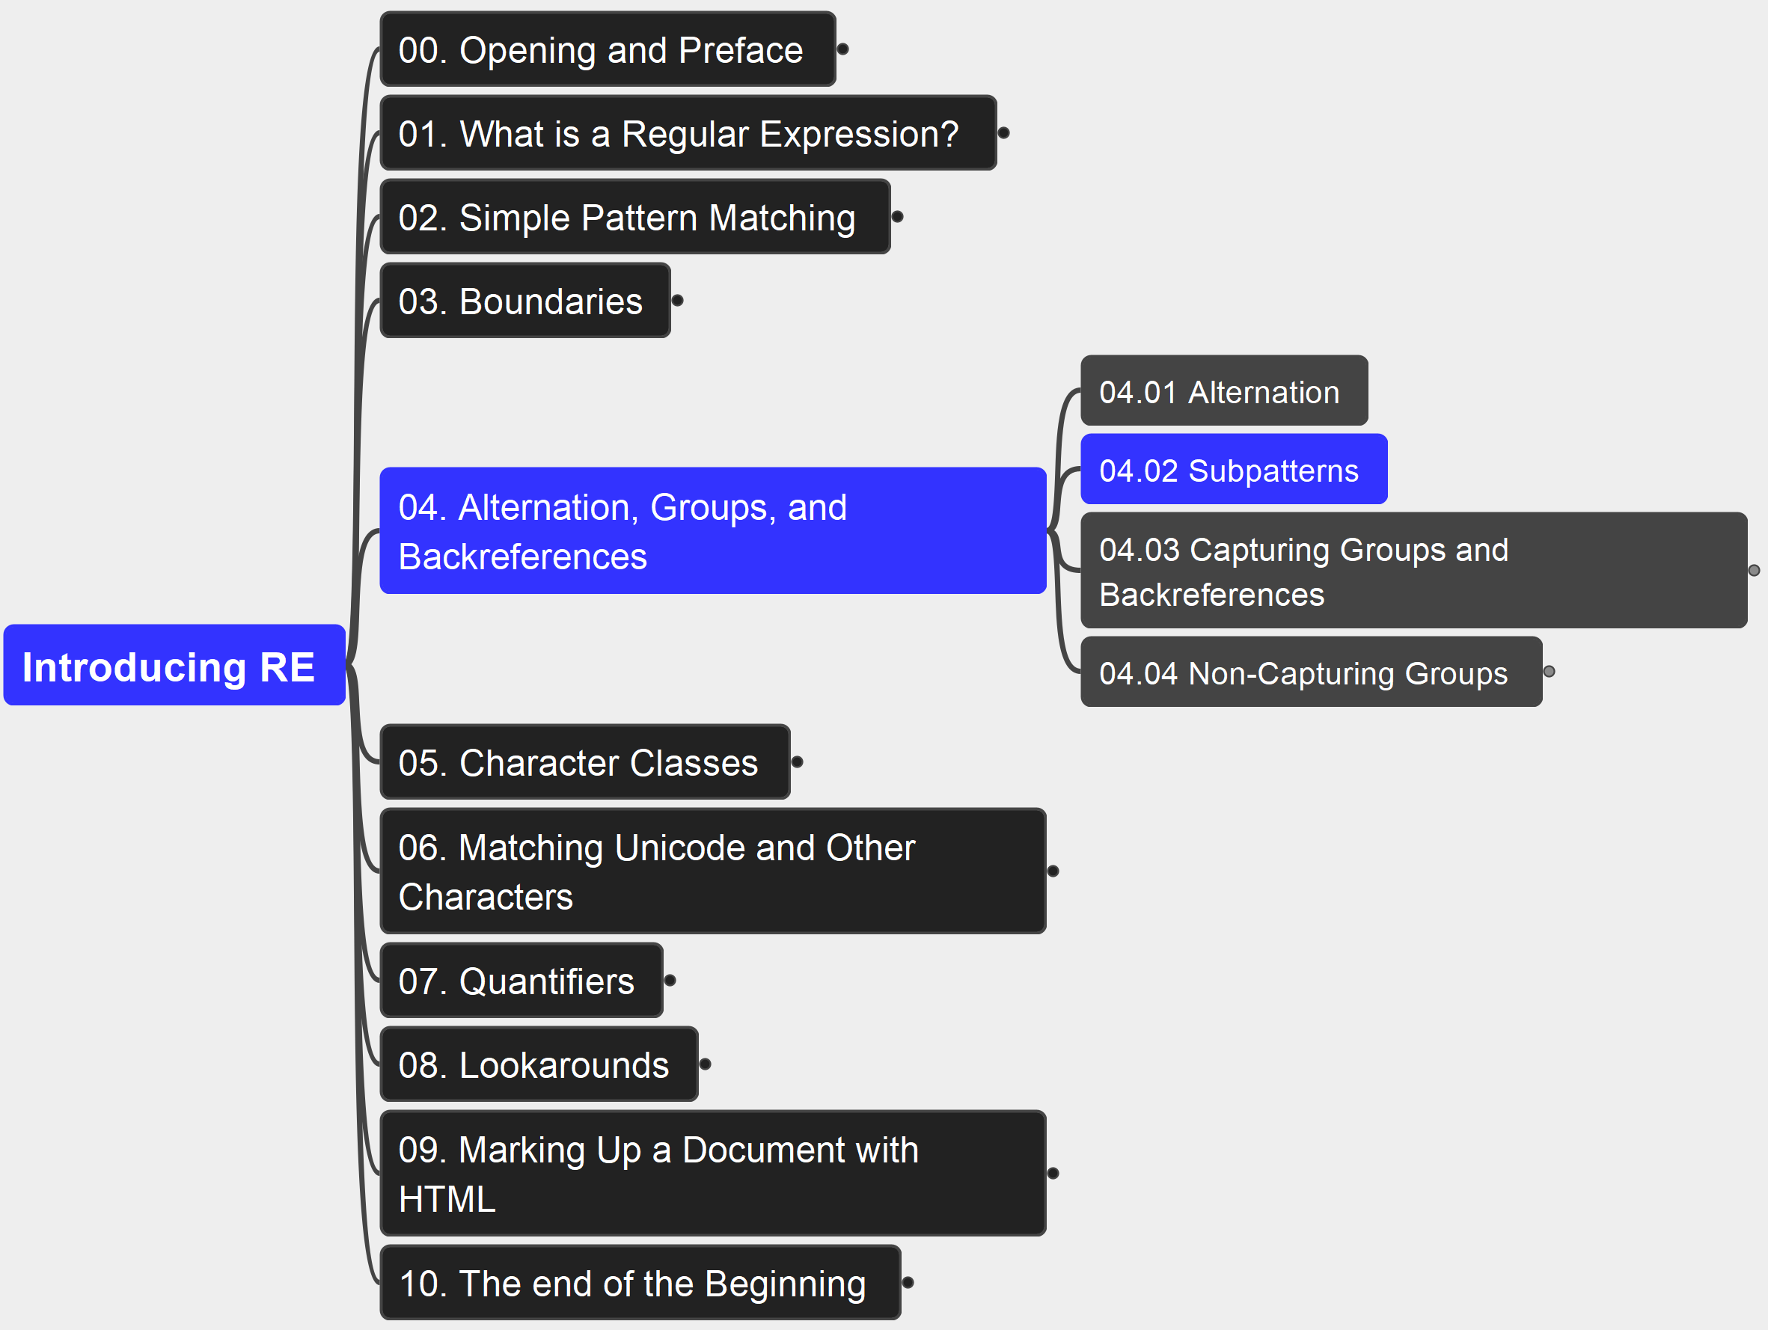
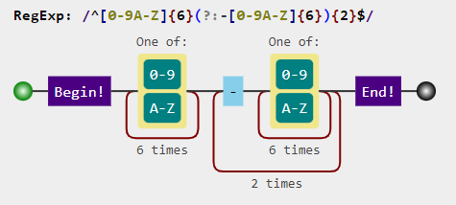
04. Alternation, Groups, and Backreferences 04.02 Subpatterns
024

Slide 25
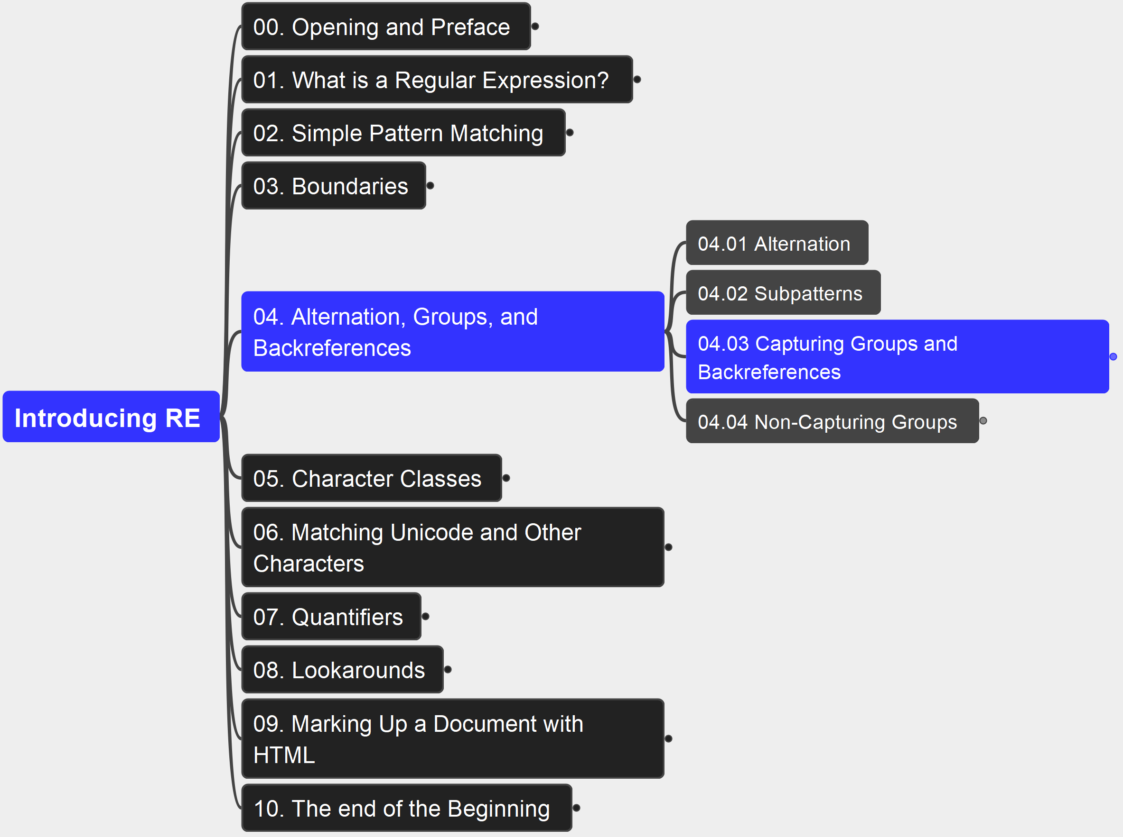
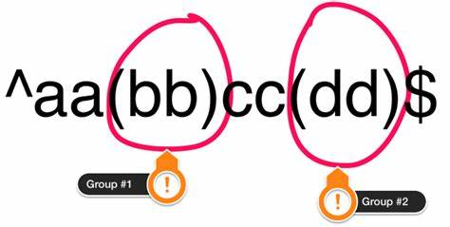
04. Alternation, Groups, and Backreferences 04.03 Capturing Groups and Backreferences
025

Slide 26
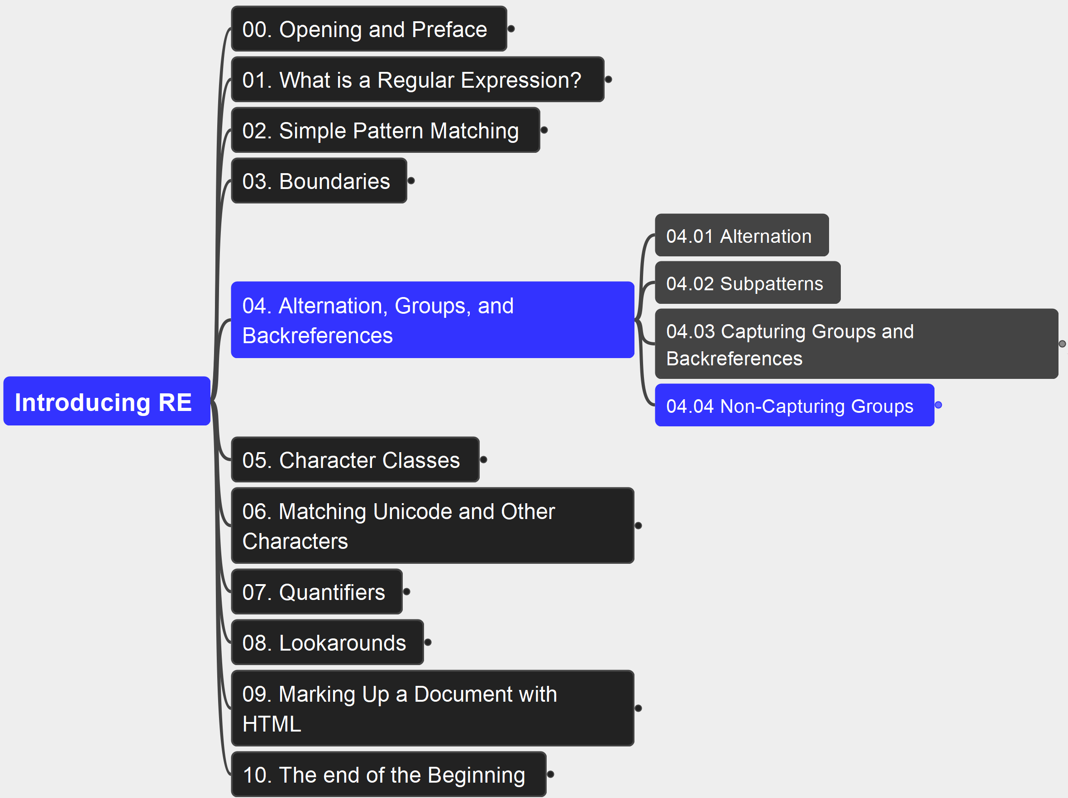
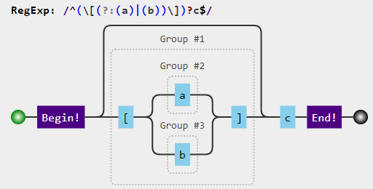
04. Alternation, Groups, and Backreferences 04.04 Non-Capturing Groups
026

Slide 27
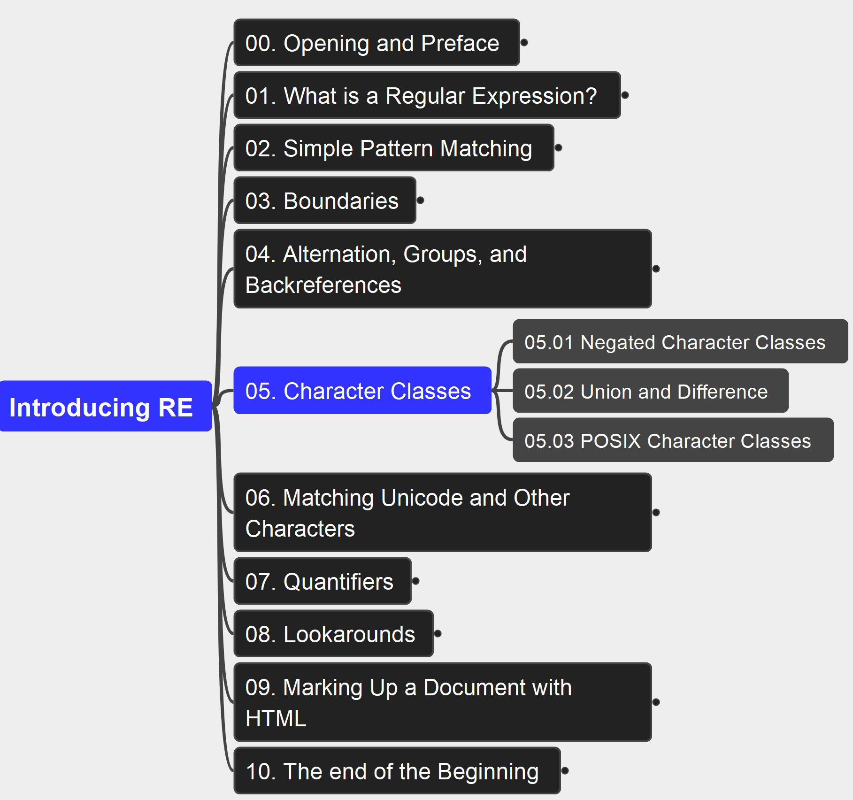

05. Character Classes 05.00 Character Classes Overview
027

Slide 28


05. Character Classes 05.01Negated Character Classes
028

Slide 29


05. Character Classes 05.02 Union and Difference
029

Slide 30


05. Character Classes 05.03 POSIX Character Classes
030

Slide 31


06. Matchin Unicode and Other Characters 06.10 Matching a Unicode Character
031

Slide 32


06. Matchin Unicode and Other Characters 06.02 Matching Characters with Octal Numbers
032

Slide 33

06. Matchin Unicode and Other Characters 06.03 Matching Unicode Character Properties
033

Slide 34


06. Matchin Unicode and Other Characters 06.04 Matching Control Characters
034

Slide 35

07. Quantifiers 07.01 Greedy, Lazy, and Possessive
035

Slide 36

07. Quantifiers 07.02 Matching with *, +, and ?
036

Slide 37

07. Quantifiers 07.03 Matching a Specific Number of Times
037

Slide 38

07. Quantifiers 07.04 Lazy Quantifiers
038

Slide 39

07. Quantifiers 07.05 Possessive Quantifiers
039

Slide 40


08. Lookarounds 08.01 Positive Lookaheads
040

Slide 41

08. Lookarounds 08.02 Negative Lookaheads
041

Slide 42

08. Lookarounds 08.03 Positive Lookbehinds
042

Slide 43

08. Lookarounds 08.04 Negative Lookbehinds
043

Slide 44


09. Marking Up a Document with HTML 09.01 Matching Tags
044

Slide 45


10 The End of the Beginning
045

Slide 46

Thank You!
xiaoqizhao@outlook.com

